Slide 1
Chemical Bonding Michael Morse, University of Utah morse@chem.utah.edu

Slide 2
Chemical Bonding Michael Morse, University of Utah morse@chem.utah.edu

Slide 3
Chemical Bonding Michael Morse, University of Utah morse@chem.utah.edu

Slide 4
Intermolecular Forces
All forces in chemistry ultimately arise from Coulomb’s law, the attraction between opposite charges. But sometimes that fundamental fact is not so obvious, due to the large number of charged particles (electrons and nuclei) in the system.
Coulomb’s Law for the force between two charges Q₁ and Q₂, when separated by distance r :
$$F= \frac{Q_{1}Q_{2}}{4πε_{0}r^{2}}$$
Specific Variations on this Theme (weakest to strongest):
1. Van der Waals or Dispersion Forces 2. Dipole-dipole attraction 3. Hydrogen bonding 4. Coulomb attraction between ions

Slide 5
Dispersion Forces
Even in highly symmetric molecules (CH₄, for example) or atoms (He, Ne, Ar,…), the charge distribution is not always symmetric. There is always a probability that the electrons at any instant will be asymmetric, as illustrated here:
This leads to a momentary dipole moment (asymmetric charge distribution) that is always possible. On average, however the dipole moment vanishes.

Slide 6
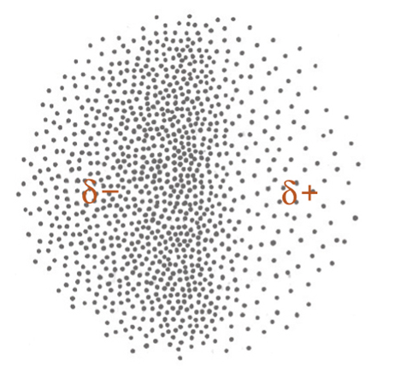
Dispersion Forces (continued)
When two atoms or molecules are close to each other, these random fluctuations in dipole moment become correlated, so the random dipoles tend to align to give a weak attraction – the dispersion force. It is roughly proportional to the number of electrons, so it becomes more important for larger molecules. It is always present, even when other forces are more important.

Slide 7
Dispersion Forces (continued)
This is why melting or boiling points tend to go up as the size of the molecule increases, even if there are no dipole moments, hydrogen bonds, or ion-ion interactions present.
Boiling Points:
He 4.6 K
Ne 25 K
Ar 87 K
Kr 116 K
Xe 161 K
Rn 211 K
Boiling Points:
CH₄ methane 109 K
C₂H₆ ethane 184 K
C₃H₈ propane 231 K
C₄H₁₀ butane 273 K
C₅H₁₂ pentane 309 K
C₆H₁₄ hexane 342 K

Slide 8
Dipole-Dipole Forces
Stronger, longer-range forces, because the molecules can orient to align dipoles favorably. However, in larger molecules, dispersion forces (which grow in magnitude with molecular size) become equally or even more important.
Dipole-dipole forces can lead to cyclic structures
or linear chain-like structures.

Slide 9
Dipole-Dipole Forces (continued)
Dipole-dipole forces grow as the dipole moment grows:
Molecule Dipole Moment Boiling Point
CH₄ 0 Debye 109 K
CH₃F 1.81 Debye 195 K
CH₂F₂ 1.98 Debye 221 K
CHF₃ 1.649 Debye 157 K
CF₄ 0 Debye 145 K
The difference between the nonpolar CH₄ and CF₄
molecules is greater dispersion forces in CF₄.

Slide 10
Hydrogen Bonding
When H is bonded to an electronegative atom (F, O, or N), the single electron of the hydrogen atom is strongly pulled toward the electronegative atom, leaving the positive charge of the proton exposed. Naturally, atoms with negative partial charges are attracted, leading to a hydrogen bond.
Like a dipole-dipole interaction, but stronger because the proton has almost no electron density to hide behind.

Slide 11
Hydrogen Bonding (continued)
Strengths of hydrogen bonds
System Typical Bond Energy
F-H-F‒ 161 kJ/mol (the bifluoride ion)
HOH•••NH₃ 29 kJ/mol
HOH•••OH₂ 21 kJ/mol
H₂NH•••NH₃ 13 kJ/mol
N-H•••O 8 kJ/mol

Slide 12
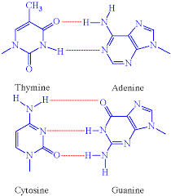
Hydrogen Bonding (continued)
Interesting hydrogen bonded facts and structures:
In the vapor phase over liquid HF, (HF)₂ and (HF)₃ are abundant.
In the vapor phase over liquid carboxylic acids, double hydrogen bonded structures, are stable – also in nonpolar solvents:
Finally, the most important
hydrogen bonded structure:
DNA – held together by hydrogen
bonds.

Slide 13
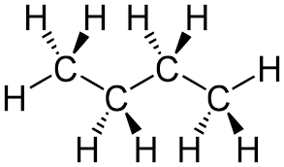
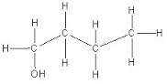
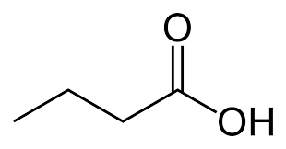
Which will have the strongest intermolecular attraction?
C₄H₁₀, butane, 0.00 Debye
C₄H₉OH, butanol, 1.66 Debye
C₄H₉Cl, butyl chloride, 2.05 Debye
4. C₄H₇O₂H, butanoic acid, 1.65 Debye

Slide 14
Which will have the strongest intermolecular attraction?
C₄H₁₀, butane, 0.00 Debye
B.P. 272 K (-1 °C)
C₄H₉OH, butanol, 1.66 Debye
B.P. 391 K (117 °C)
C₄H₉Cl, butyl chloride, 2.05 Debye
B.P. 352 K (78 °C)
4. C₄H₇O₂H, butanoic acid, 1.65 Debye
B.P. 437 K (164 °C)

Slide 15
Now, for “real” chemical bonds
Actually, even the best chemical researchers still debate what is, and what isn’t a chemical bond. But we can still think of two limiting types of bonds:
Ionic Bonds – These are easily understood as arising from the Coulomb attraction between ions with opposite charges
Covalent Bonds – These are more difficult to understand, and really require quantum mechanics

Slide 16
Ionic Bonds
Bonding force given by Coulomb’s Law directly:
$$F= \frac{Q_{1}Q_{2}}{4πε_{0}r^{2}}$$
Binding energy is greatest for large charges, small separations.
Crystal Melting Point
LiF 1118 K
NaCl 1074 K
KBr 1007 K
CsI 894 K
Crystal Melting Point
NaF 1266 K
Na₂O 1405 K
MgF₂ 1536 K
MgO 3125 K

Slide 17
Ionic Bonds
Which crystal will have the highest melting point?
Which will have the lowest melting point?
Crystal
BaS
CsCl
BaO
SrS
SrO

Slide 18
Ionic Bonds
Which crystal will have the highest melting point?
Which will have the lowest melting point?
Crystal Melting Point
BaS 1200 ºC
CsCl 645 ºC
BaO 1973 ºC
SrS 2002 ºC
SrO 2531 ºC

Slide 19
Covalent Bonds start with atomic orbitals
In atomic H, one electron moving in the field of one proton, gives us wavefunctions that are the atomic orbitals:
Here I’m showing the probability density of the electron in the various orbitals. The wavefunctions have phases; some regions are positive, some negative.

Slide 20
Covalent Bonds (continued)
Now move to the simplest molecule, H₂⁺. Again, the single electron moves in the field of the nuclei, but now there are two of them. If we imagine fixing the two nuclei at a certain separation (R), we can solve for the orbitals of this molecule (molecular orbitals). As for atoms, there are many different solutions, with different energies.
Usually, it is convenient to approximate the molecular orbitals as sums of atomic orbitals (the linear combination of atomic orbitals, or LCAO method).

Slide 21
Molecular Orbitals of H₂⁺
In the LCAO method, atomic orbitals of similar energies and of the same symmetry on the two atoms combine to give the molecular orbitals. For H₂⁺, this means that the 1s orbitals combine.
A key point: You get as many molecular orbitals as you have atomic orbitals in the system. Since you have 2 hydrogen atoms, you get 2 molecular orbitals formed from the 1s orbitals on the two centers. For symmetric molecules like H₂⁺, these are just the sum and difference of the atomic orbitals.

Slide 22
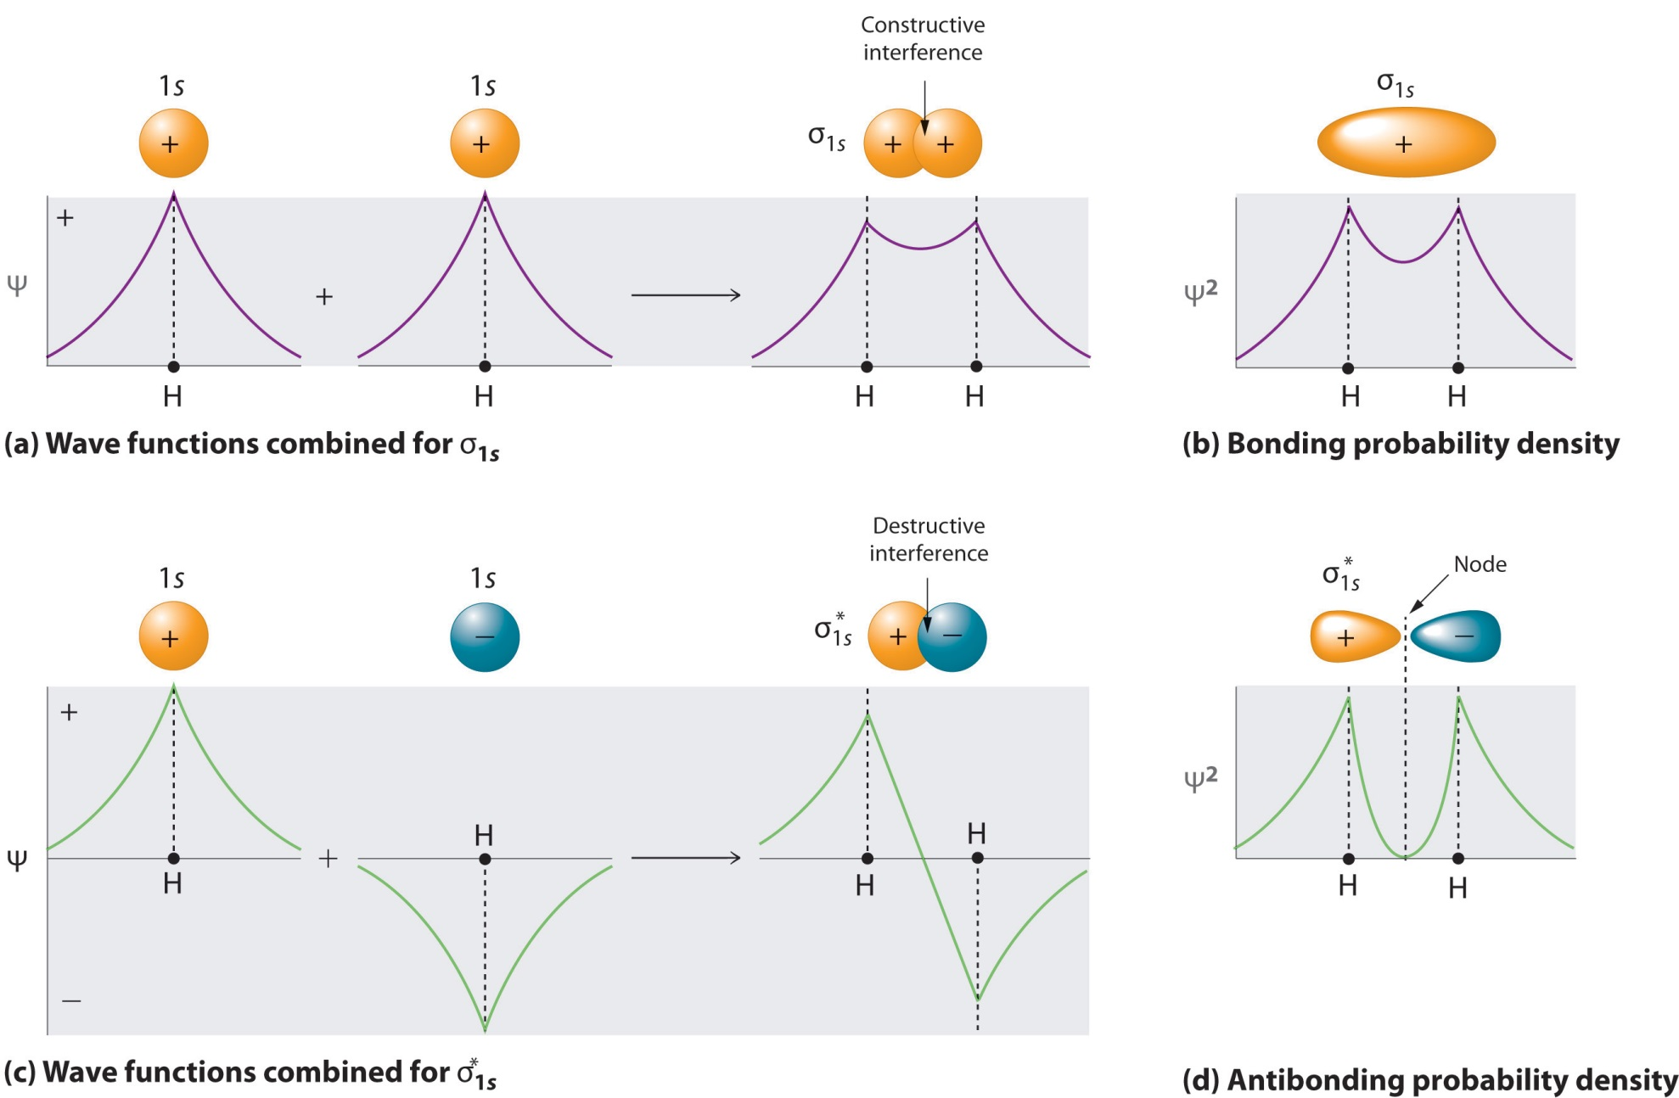
Molecular Orbitals of H₂⁺

Slide 23
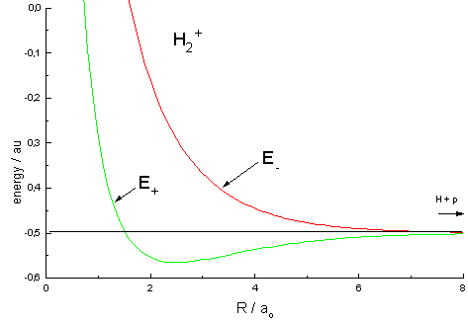
Molecular Orbitals of H₂⁺
Higher energy orbitals also exist, but they are MUCH higher in energy, deriving from the 2s, 2p, etc. orbitals.
Orbital energy (hartrees)
σ*
σ
}
Bond energy of H₂⁺
Internuclear separation (a₀)
Equilibrium bond length of H₂⁺

Slide 24
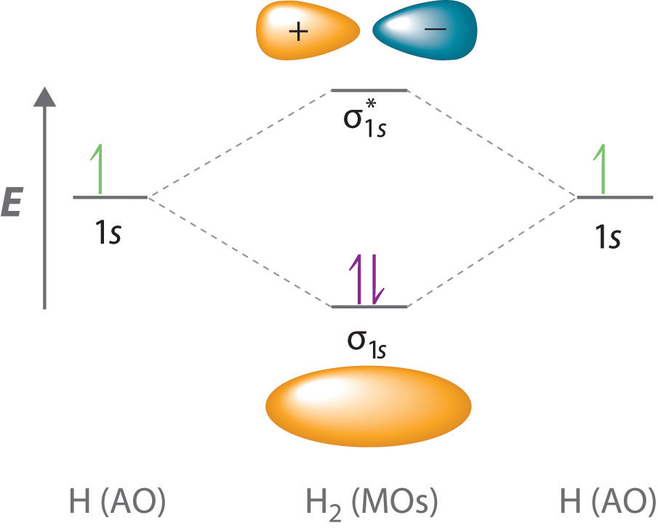
Molecular Orbitals of H₂⁺
To simplify, we often only consider the molecule at its equilibrium geometry and
don’t consider how the energy changes as the molecule is formed. This lets us
construct MO diagrams like this:
+
+

Slide 25
Molecular Orbitals of H₂
For H₂, there’s not much difference, just add one more electron.
Both electrons drop in
energy when H₂ is formed,
so the bond energy is
greater than in H₂⁺:
D(H₂⁺) = 2.69 eV
D(H₂) = 4.48 eV

Slide 26
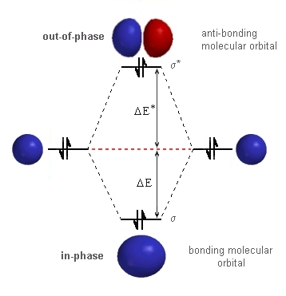
Molecular Orbitals of He₂
For He₂ there are 4 electrons altogether, so the next two go into the antibonding orbital.
It turns out that the antibonding
orbital is raised up in energy
somewhat higher above the
atomic orbital than the bonding
orbital is lowered. The net affect
is that the two atoms repel one
another.
However, dispersion forces still
lead to a very slight attraction.
He₂ does exist, but the “bond”
energy is only 0.000000095 eV
and its “bond” length is 52 Å
(compared to 0.74 Å for H₂).
This is the weakest and longest
“bond” known.

Slide 27
Valence vs. Core Atomic Orbitals
If we look at the atomic orbital energies as a function
of atomic number, the energies drop very rapidly:
As they drop, they get
much smaller too:
H₂ σ_{1s}
Li₂ σ_{1s}
No orbital overlap
implies a core orbital,
not a valence orbital.

Slide 28
Valence vs. Core Atomic Orbitals
Zooming in:
Valence Orbitals
Core Orbitals

Slide 29
Homonuclear Diatomic Molecules
Molecule Electronic configuration Bond Length Bond Strength B.O.
H₂ σ_{1s}² 0.74144 Å 4.478 eV 1
He₂ σ_{1s}² σ_{1s}*² 52 Å 0.000000095 eV 0
Li₂ [σ_{1s}² σ_{1s}*²] σ_{2s}² 2.673 Å 1.05 eV 1
Be₂ [σ_{1s}² σ_{1s}*²] σ_{2s}² σ_{2s}*² 2.445 Å 0.116 eV 0
Two electrons in a bonding orbital denote a bond, and antibonding electrons cancel out the effects of the bond. Therefore, we can define the bond order as
B.O. = $\frac{1}{2} \left(number of bonding electrons −number of antibonding electrons\right)$
There’s no need to consider the core electrons (in square brackets []), because they don’t overlap sufficiently to be considered either bonding or antibonding.
Note: All bonds are not of equal strength! The single bond in Li₂ is much weaker than that of H₂. That’s because the 2s orbital of Li is much larger and more diffuse than the 1s orbital of H.

Slide 30
p-orbital bonding
When the p orbitals are involved, you can get two different types of bonds:
bonds and π bonds.
σ orbitals have cylindrical symmetry about the molecular axis,
no nodal planes containing the axis
orbitals have one nodal plane containing the axis
σ interaction of 2p orbitals:
π interaction of 2p orbitals:
Atom Atom
A B
Atom Atom
A B
In each orientation, the orbitals can approach so they overlap constructively to
form bonding orbitals, or destructively to form antibonding orbitals.
σ_{2p} σ_{2p}*
π_{2p} π_{2p}*

Slide 31
Energy ordering of p-based MOs
Looking at the p-based molecular orbitals, it seems obvious that the greatest build-up of electron density between the nuclei will be in the σ_{2p} orbital, so it should be the strongest bond. Next would be the π_{2p} , which is also a good bonding orbital, then π_{2p}* should be less antibonding than σ_{2p}*. This is correct unless there is an outside influence.
This leads to the correct orbital diagrams for O₂ ,F₂ , and Ne₂:
B.O.(O₂) = $\frac{1}{2}\left(8−4\right)=2$
B.O.(F₂) = $\frac{1}{2}\left(8−6\right)=1$

Slide 32
Energy ordering of p-based MOs
In B₂, C₂, and N₂, however, the ordering is different, with the π_{2p} orbitals lying below the σ_{2p} orbital. Why?
This comes back to the way the orbitals drop in energy as nuclear charge increases.
In B₂, C₂, and N₂, the 2s and 2p orbitals
are close enough in energy that they can
mix to form what are essentially 2s-2p
hybrids. In the process the σ_{2s} (which is
no longer purely 2s) becomes a better
bonding orbital and the σ_{2p} (which is also
no longer purely 2p) becomes a worse
bonding orbital.
This interaction is strong enough to
reverse the order of the σ_{2p} and π_{2p}
orbitals in B, C, and N, where the 2s and
2p are close in energy, but not in O, F, and
Ne.

Slide 33
sp-hybrid MOs
sp-hybrids are formed by first adding (or subtracting) the 2p orbital to the 2s orbital. Since two atomic orbitals are combined in this way, two hybrid orbitals are obtained.
Then the four sp-hybrids (2 on each atom) are combined to form a really good
bonding orbital and a really bad bonding orbital, along with two antibonding orbitals:
+
= great overlap, good bonding orbital
hybridization lowers the energy of σ_{2s}
+
= poor overlap, poor bonding orbital
hybridization increases the energy of σ_{2p}, so it lies above
the π_{2p} orbital in B₂, C₂, and N₂

Slide 34
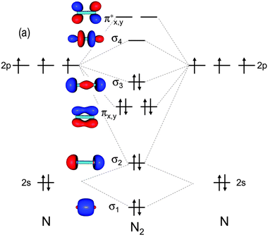
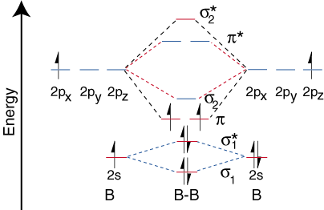
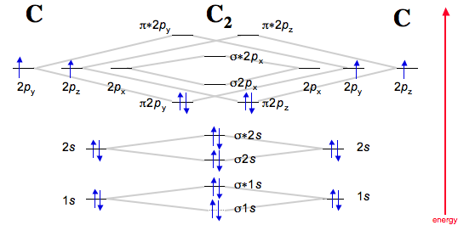
Energy ordering of p-based MOs
In B₂, C₂, N₂ the revised energy ordering is found:
B₂ C₂ N₂
Electronic configuration (valence electrons only):
σ_{2s}² σ_{2s}*²π_{2p}² σ_{2s}² σ_{2s}*²π_{2p}⁴ σ_{2s}² σ_{2s}*²π_{2p}⁴ σ_{2p}²
Bond Order:
1 2 3
no σ bonds no σ bonds one σ bond
one π bond two π bonds two π bonds
Bond Length:
1.590 Å 1.243 Å 1.098 Å
Bond Energy:
3.02 eV 6.21 eV 9.76 eV

Slide 35
Homonuclear Diatomic Molecules
Molecule Electronic configuration Bond Length Bond Strength B.O.
H₂ σ_{1s}² 0.74144 Å 4.48 eV 1
He₂ σ_{1s}² σ_{1s}*² 52 Å 0.000000095 eV 0
Li₂ σ_{2s}² 2.673 Å 1.05 eV 1
Be₂ σ_{2s}² σ_{2s}*² 2.445 Å 0.12 eV 0
B₂ σ_{2s}² σ_{2s}*² π_{2p}² 1.590 Å 3.02 eV 1
C₂ σ_{2s}² σ_{2s}*² π_{2p}⁴ 1.243 Å 6.21 eV 2
N₂ σ_{2s}² σ_{2s}*² π_{2p}⁴ σ_{2p}² 1.098 Å 9.76 eV 3
O₂ σ_{2s}² σ_{2s}*² σ_{2p}² π_{2p}⁴ π_{2p}*² 1.208 Å 5.12 eV 2
F₂ σ_{2s}² σ_{2s}*² σ_{2p}² π_{2p}⁴ π_{2p}*⁴ 1.412 Å 1.60 eV 1
Ne₂ σ_{2s}² σ_{2s}*² σ_{2p}² π_{2p}⁴ π_{2p}*⁴σ_{2p}*² unknown tiny 0

Slide 36
Homonuclear Diatomic Molecules
GREAT QUESTIONS FOR AP STUDENTS:
1. Is the ionization energy of X₂ greater than that of the atom, or less than that
of the atom? Let’s compare N₂ and O₂.
Energy of a free electron
IE(N₂)
IE(N)
Because the HOMO of the N₂ molecule is a bonding orbital, that electron is held more tightly than it is in the atom. Thus, we expect IE(N₂) > IE(N).
Experimentally:
IE(N₂) = 15.581 eV
IE(N) = 14.534 eV
YES! Just as we predicted.

Slide 37
Homonuclear Diatomic Molecules
GREAT QUESTIONS FOR AP STUDENTS:
1. Is the ionization energy of X₂ greater than that of the atom, or less than that
of the atom? Let’s compare N₂ and O₂.
Energy of a free electron
IE(O₂)
IE(O)
Because the HOMO of the O₂ molecule is an antibonding orbital, that electron is held less tightly than it is in the atom. Thus, we expect IE(O₂) < IE(O).
Experimentally:
IE(O₂) = 12.071 eV
IE(O) = 13.618 eV
YES! Just as we predicted.

Slide 38
Homonuclear Diatomic Molecules
GREAT QUESTIONS FOR AP STUDENTS:
2. Is the bond energy of X₂ greater than that of X₂⁺, or less? Let’s compare O₂ and O₂⁺.
For O₂, the bond order is 2, because
there are 8 bonding electrons and
4 antibonding electrons. When it is
ionized, we remove an antibonding
electron, so the bond order of O₂⁺ is 2.5.
The bond dissociation energy of O₂⁺
should be greater than that of O₂.
Experimentally, the bond energies are:
O₂ 5.116 eV
O₂⁺ 6.663 eV

Slide 39
Homonuclear Diatomic Molecules
GREAT QUESTIONS FOR AP STUDENTS:
3. Is X₂ diamagnetic (weakly repelled by a magnetic field) or paramagnetic
(attracted into a magnetic field).
This is just a hidden way of asking if the molecule has unpaired electrons.
If it has unpaired electrons, the unpaired spin causes it to be paramagnetic.
Examples of paramagnetic molecules that are stable:
O₂ σ_{2s}² σ_{2s}*² σ_{2p}² π_{2p}⁴ π_{2p}*² (Here the last two π_{2p}* electrons go into the π_{2p}*
orbitals with parallel spins, causing O2 to be a high spin molecule that is attracted
into a magnetic field.)
NO σ_{2s}² σ_{2s}*² σ_{2p}² π_{2p}⁴ π_{2p}*¹ (Here there is only one unpaired electron, but that is
enough! NO is a paramagnetic molecule.)
All radicals (molecules with unpaired spins) are paramagnetic.

Slide 40
d-orbital bonding
If the bonding is between transition metals, you can get d-orbital bonding.
For the internuclear axis defined as the z-axis, you can combine the d_{z}2 orbtals to get bonding and antibonding dσ orbitals:
+
=
dσ bonding orbital
-
=
dσ∗ antibonding orbital

Slide 41
d-orbital bonding
If you combine the d_{xz} orbitals (or the d_{yz} orbitals), you can get dπ bonding and antibonding orbitals.
-
=
dπ bonding orbital
-
=
dπ bonding orbital
+
=
dπ antibonding orbital
+
=
dπ antibonding orbital

Slide 42
d-orbital bonding
If you combine the d_{xz} orbitals (or the d_{yz} orbitals), you can get dπ bonding and antibonding orbitals.
-
=
dπ bonding orbital
-
=
dπ bonding orbital
+
=
dπ∗ antibonding orbital
+
=
dπ∗ antibonding orbital

Slide 43
d-orbital bonding
If you combine the d_{xy} orbitals (or the d_{x2-y2} orbitals), you can get dδ bonding and antibonding orbitals.
+
=
dδ bonding orbital
+
=
dδ bonding orbital
-
=
dδ∗ antibonding orbital
-
=
dδ∗ antibonding orbital

Slide 44
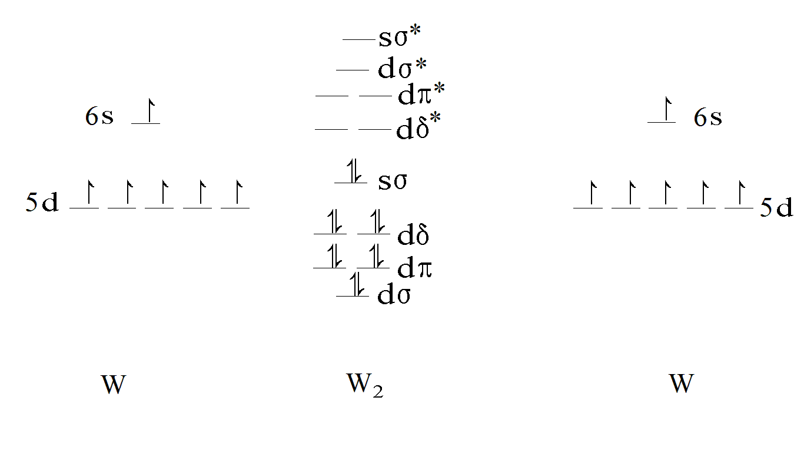
d-orbital bonding in W₂
Tungsten dimer has a sextuple bond!

Slide 45
d-orbital bonding in W₂
≡
W W
≡

Slide 46
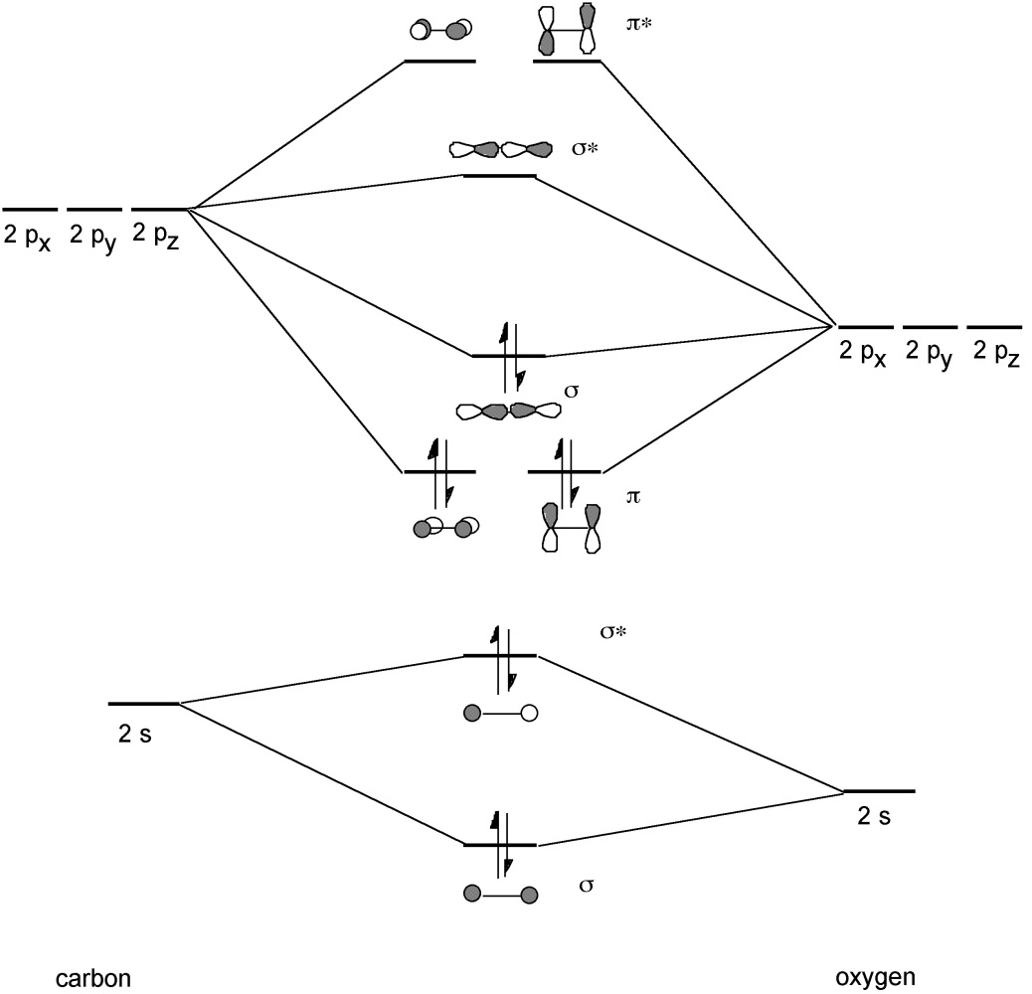
Heteronuclear Diatomic Molecules
If the nuclei are different, the more electronegative atom holds onto its electrons more tightly, so its atomic orbitals are pushed to lower energies.
Molecular orbitals are formed by combining atomic orbitals that lie at similar energies, that have the same symmetry (σ or π), and that overlap well.
In CO, the two atoms aren’t very different, so the molecular orbital diagram is just a slight change from N₂.
C CO O

Slide 47
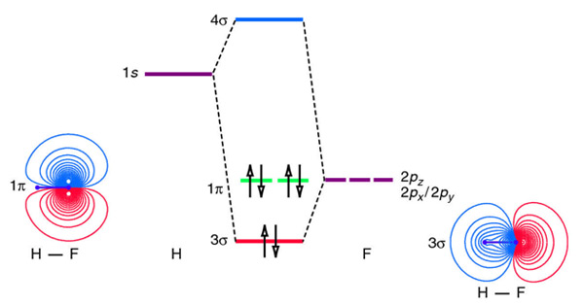
Heteronuclear Diatomic Molecules
If the nuclei are very different, the same rules apply.
For example, in HF, the F atom has a higher ionization energy, so its 2p orbitals lie below the 1s of hydrogen. However, the 1s of hydrogen has cylindrical symmetry about the H-F axis, so it is of σ-type and can only combine with the 2p_{z} orbital, which is also of σ-type. The 2p_{x} and 2p_{y} orbitals of F are of π-type, and have nothing to interact with on the hydrogen. They don’t shift in energy.

Slide 48
Valence Bond Theory
Molecular orbital theory – useful, explains small molecules well, good for understanding excited electronic states (and spectroscopy).
Valence bond theory – more obvious for extensions to polyatomics.
Basic Idea: Electrons stay in atomic orbitals but are spin-paired to form a bond when the atoms approach and the atomic orbitals overlap.

Slide 49
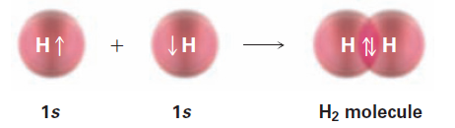
Valence Bond Theory of H₂
The VB and MO approaches represent different approximations in the solution of $\hat{H}ψ=Eψ$.
In the MO approach, both electrons are in the same molecular orbital, which extends over the entire molecule. There is therefore a certain probability that they’ll be found on the same atom. Thus, you get equal contributions from structures like H⁺H‒ and H‒H⁺ (ionic structures) and an equal contribution from covalent structures (where each atom has one electron on it). The MO method gives 50% covalent, 50% ionic character in the wavefunction.
In the VB approach, the ionic structures are completely eliminated and only covalent structures are included. The VB method gives a wavefunction that is 100% covalent.
A better method optimizes the amount of covalent vs. ionic character, and gets 93.7% covalent and 6.3% ionic character. So VB is closer to the truth for H₂.

Slide 50
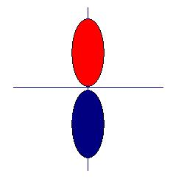
Valence Bond Theory of HF
+
→
↑
+
↓
→
↑↓
As you can see, VB theory has its origin in Lewis dot structures.
Unfortunately, actual calculations using VB theory are more difficult than MO theory, so it isn’t used that much in actual computational chemistry.

Slide 51
Bonds to multiple atoms: hybridization
To form equivalent bonds to multiple atoms, hybrid orbitals are formed by forming linear combinations of atomic orbitals on the central atom.
Example: sp hybrid orbitals:
The other two 2p orbitals are then unused in forming the hybrids, and are oriented perpendicular to the z-axis.
+
→
z
2s + 2p → sp hybrid 1
+
→
z
2s - 2p → sp hybrid 2

Slide 52
sp hybrid orbitals (continued)
These sp hybrid orbitals are perfect for forming bonds to two different atoms to form a linear three-atom structure, like HCN.
Lewis dot structure: H:C:::N:
Each electron pair is represented
by a different diagram here.
↑↓
C N sigma bond
↑↓
The nitrogen atom is also
sp-hybridized, with the other
hybrid projecting out the back
as a lone pair.
H C sigma bond
N lone pair
↑↓

Slide 53
sp hybrid orbitals (continued)
Finally, the two p orbitals that weren’t used on C combine with the two 2p orbitals that weren’t used on N to form two sets of π bonds.
↓
↑
H C N
The other π bond is oriented 90 degrees to this one.

Slide 54
Other hybridizations: sp²
For a central atom that has 3 sigma bonds to other atoms (or lone pairs), the hybridization is sp². This means that two p orbitals and one s orbital combine to make three equivalent hybrid atomic orbitals.
If the three equivalent orbitals are in the x-y plane, they are formed from s, p_{x}, and p_{y}, leaving the p_{z} orbital free to form a π bond. The three hybrid orbitals are then all in the same plane.
Examples: BF₃
CH₂O

Slide 55
Other hybridizations: sp³
For a central atom that has 4 sigma bonds to other atoms (or lone pairs), the hybridization is sp³. This means that three p orbitals and one s orbital combine to make four equivalent hybrid atomic orbitals. These are formed from the s, p_{x}, p_{y}, and p_{z} orbitals.
Examples: CH₄, NH₃, H₂O

Slide 56
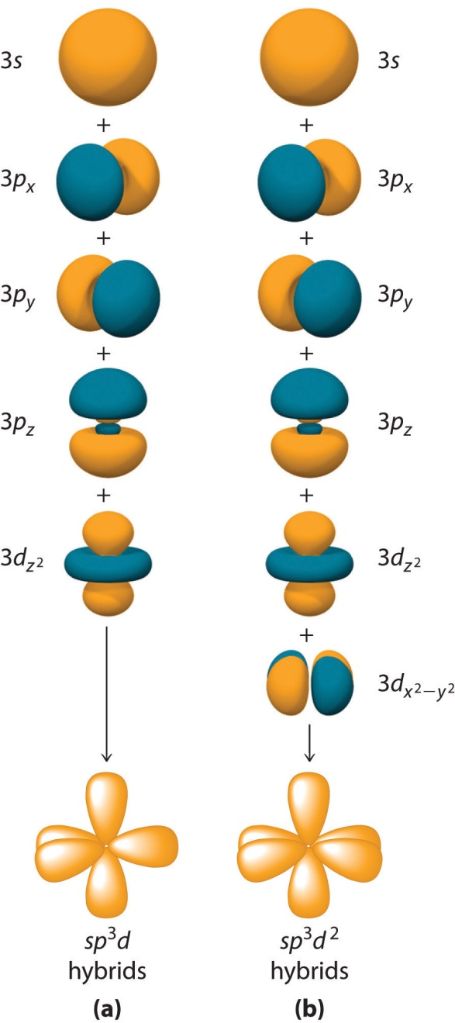
Other hybridizations: sp³d and sp³d²
For 5 or 6 sigma bonds (or lone pairs) on a central atom, the atom must be hybridized sp³d or sp³d² , respectively.
For sp³d, this is easily understood as forming sp² hybrids in one plane, leading to a trigonal planar portion of the molecule, then combining the remaining p_{z} orbital with the d_{z}2 to generate hybrids pointing along the +z and –z axis.

