Slide 1
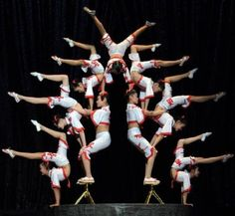
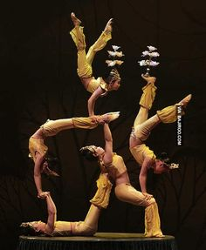
Equilibrium
Michael Morse
Department of Chemistry
University of Utah
Saturday, September 19, 2015

Slide 2
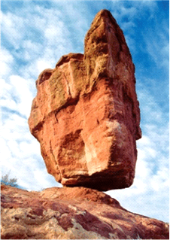
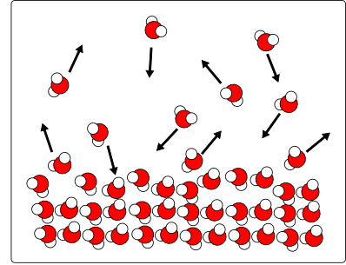
What is equilibrium?
Equilibrium is a state of balance between opposing forces or actions that is either static (as in a body acted on by forces whose resultant is zero) or dynamic (as in a reversible chemical reaction when the rates of reaction in both directions are equal)
– Merriam-Webster online dictionary
Static equilibrium Dynamic equilibrium
(more relevant to mechanics) (more relevant to chemistry)

Slide 3
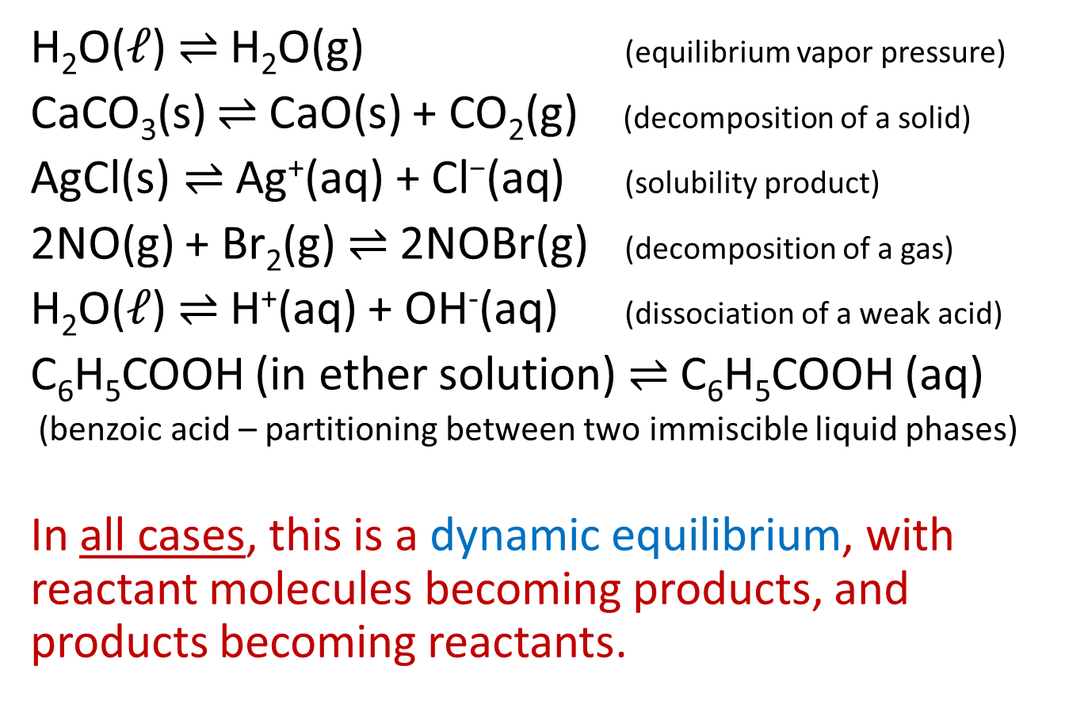
Examples of chemical equilibria
H₂O($ℓ$) $⇌$ H₂O(g) (equilibrium vapor pressure)
CaCO₃(s) $⇌$ CaO(s) + CO₂(g) (decomposition of a solid)
$\text{AgCl}\text{(}\text{s}\text{)}⇌$ $\text{Ag}\text{+}\text{(}\text{aq}\text{) + }\text{Cl}\text{−}\text{(}\text{aq}\text{)}$ (solubility product)
2NO(g) + Br₂(g) $⇌$ 2NOBr(g) (decomposition of a gas)
H₂O($ℓ$) $⇌$ H⁺(aq) + OH⁻(aq) (dissociation of a weak acid)
C₆H₅COOH (in ether solution) $⇌$ C₆H₅COOH (aq)
(benzoic acid – partitioning between two immiscible liquid phases)
In all cases, this is a dynamic equilibrium, with reactant molecules becoming products, and products becoming reactants.

Slide 4
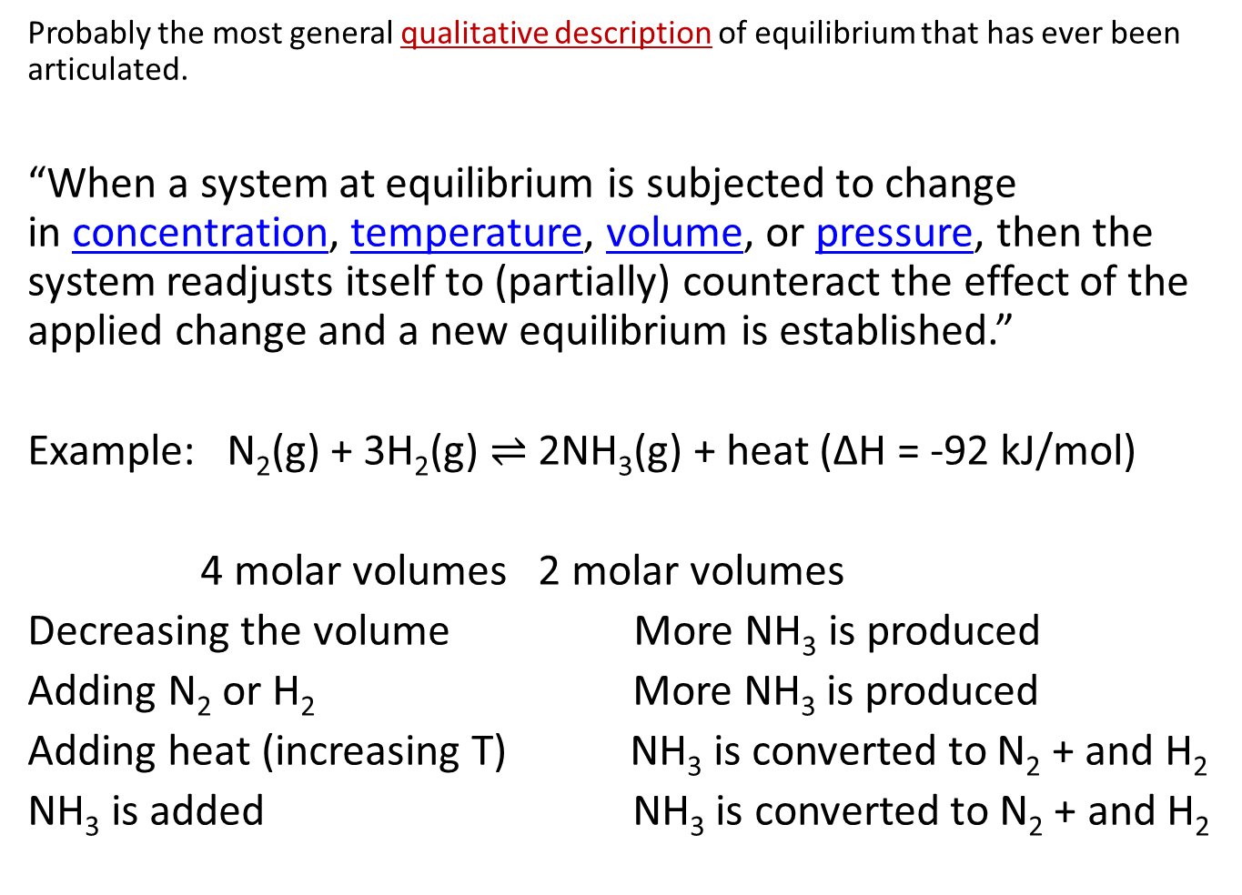
Le Châtelier’s Principle
Probably the most general qualitative description of equilibrium that has ever been articulated.
“When a system at equilibrium is subjected to change in concentration, temperature, volume, or pressure, then the system readjusts itself to (partially) counteract the effect of the applied change and a new equilibrium is established.”
Example: N₂(g) + 3H₂(g) $⇌$ 2NH₃(g) + heat (ΔH = -92 kJ/mol)
4 molar volumes 2 molar volumes
Decreasing the volume More NH₃ is produced
Adding N₂ or H₂ More NH₃ is produced
Adding heat (increasing T) NH₃ is converted to N₂ + and H₂
NH₃ is added NH₃ is converted to N₂ + and H₂

Slide 5
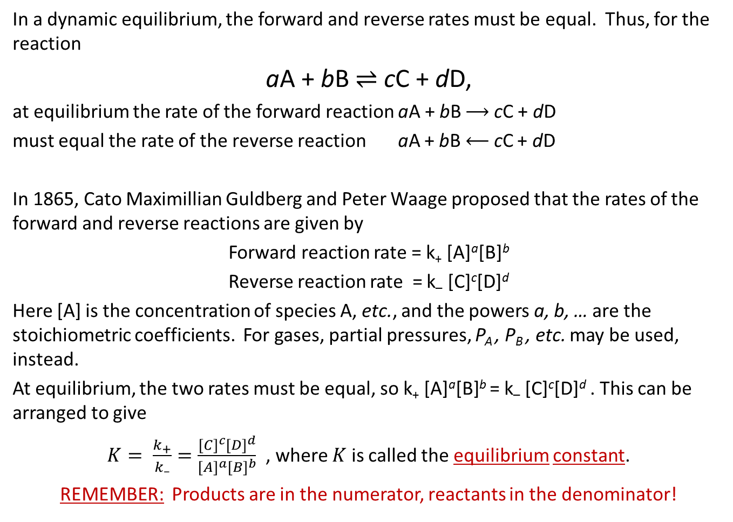
Kinetic model for equilibrium
In a dynamic equilibrium, the forward and reverse rates must be equal. Thus, for the reaction
aA + bB $⇌$ cC + dD,
at equilibrium the rate of the forward reaction aA + bB $⟶$ cC + dD
must equal the rate of the reverse reaction aA + bB $⟵$ cC + dD
In 1865, Cato Maximillian Guldberg and Peter Waage proposed that the rates of the forward and reverse reactions are given by
Forward reaction rate = k₊ [A]ª[B]^{b}
Reverse reaction rate = k– [C]^{c}[D]^{d}
Here [A] is the concentration of species A, etc., and the powers a, b, … are the stoichiometric coefficients. For gases, partial pressures, P_{A} , P_{B} , etc. may be used, instead.
At equilibrium, the two rates must be equal, so k₊ [A]ª[B]^{b} = k– [C]^{c}[D]^{d} . This can be arranged to give
$K= \frac{k_{+}}{k_{–}}=\frac{{[C]}^{c}{[D]}^{d}}{{[A]}^{a}{[B]}^{b}}$ , where $K$ is called the equilibrium constant.
REMEMBER: Products are in the numerator, reactants in the denominator!

Slide 6
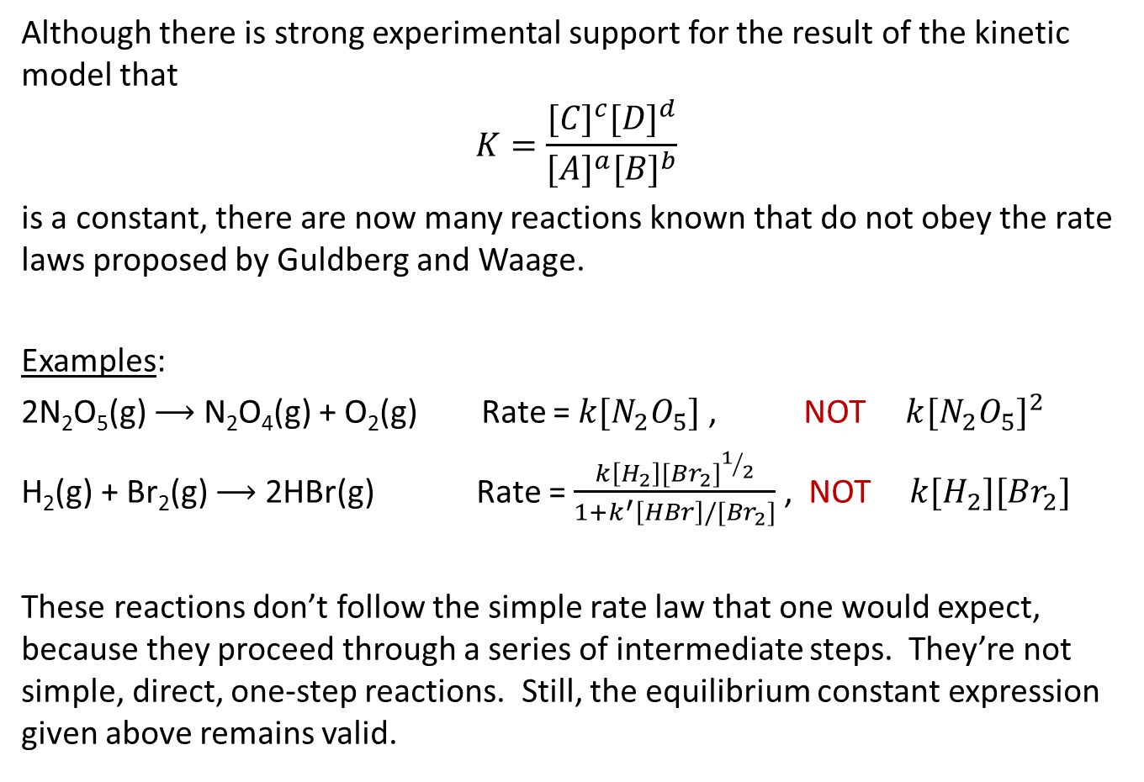
Problems with the kinetic model
Although there is strong experimental support for the result of the kinetic model that
$$K=\frac{{[C]}^{c}{[D]}^{d}}{{[A]}^{a}{[B]}^{b}}$$
is a constant, there are now many reactions known that do not obey the rate laws proposed by Guldberg and Waage.
Examples:
2N₂O₅(g) $⟶$ N₂O₄(g) + O₂(g) Rate = $k[N_{2}O_{5}]$ , NOT ${k[N_{2}O_{5}]}^{2}$
H₂(g) + Br₂(g) $⟶$ 2HBr(g) Rate = $\frac{k\left[H_{2}\right]{[{Br}_{2}]}^{1/2}}{1+k^{′}\left[HBr\right]/[{Br}_{2}]}$ , NOT $k[H_{2}][{Br}_{2}]$
These reactions don’t follow the simple rate law that one would expect, because they proceed through a series of intermediate steps. They’re not simple, direct, one-step reactions. Still, the equilibrium constant expression given above remains valid.

Slide 7
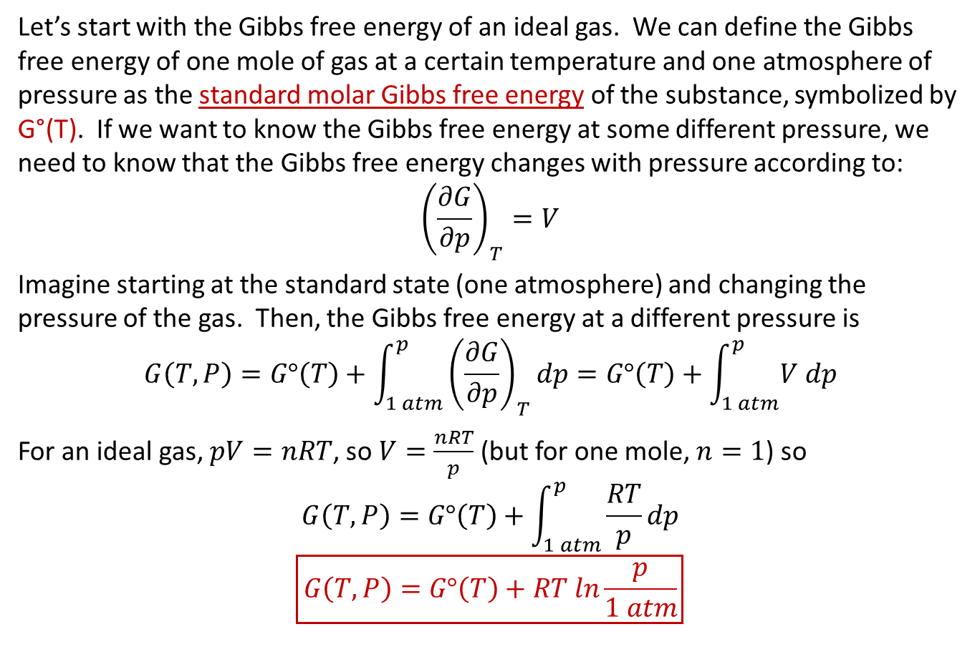
Thermodynamic model for equilibrium
Let’s start with the Gibbs free energy of an ideal gas. We can define the Gibbs free energy of one mole of gas at a certain temperature and one atmosphere of pressure as the standard molar Gibbs free energy of the substance, symbolized by G°(T). If we want to know the Gibbs free energy at some different pressure, we need to know that the Gibbs free energy changes with pressure according to:
$${\left(\frac{∂G}{∂p}\right)}_{T}=V$$
Imagine starting at the standard state (one atmosphere) and changing the pressure of the gas. Then, the Gibbs free energy at a different pressure is
$$G\left(T, P\right)=G°\left(T\right)+\int_{1 atm}^{p}{{\left(\frac{∂G}{∂p}\right)}_{T}dp}=G°\left(T\right)+\int_{1 atm}^{p}{V dp}$$
For an ideal gas, $pV=nRT$, so $V=\frac{nRT}{p}$ (but for one mole, $n=1$) so
$$G\left(T, P\right)=G°\left(T\right)+\int_{1 atm}^{p}{\frac{RT}{p}dp}$$
$$\boxed{G\left(T, P\right)=G°\left(T\right)+RT ln\frac{p}{1 atm}}$$

Slide 8
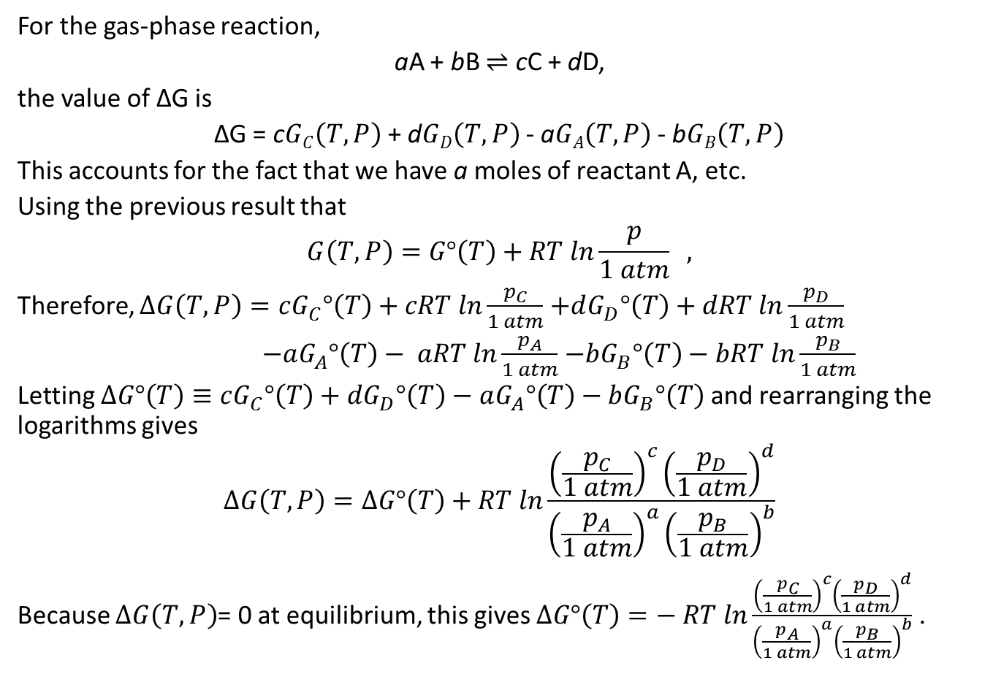
At equilibrium, ΔG = 0.
For the gas-phase reaction,
aA + bB $⇌$ cC + dD,
the value of ΔG is
ΔG = c$GC\left(T, P\right)$ + d$GD\left(T, P\right)$ - a$GA\left(T, P\right)$ - b$GB\left(T, P\right)$
This accounts for the fact that we have a moles of reactant A, etc.
Using the previous result that
$$G\left(T, P\right)=G°\left(T\right)+RT ln\frac{p}{1 atm} ,$$
Therefore, $ΔG\left(T,P\right)=cG_{C}^{}°\left(T\right)+cRT ln\frac{p_{C}}{1 atm}$ $+dG_{D}^{}°\left(T\right)+dRT ln\frac{p_{D}}{1 atm}$
$−aG_{A}^{}°\left(T\right)− aRT ln\frac{p_{A}}{1 atm}$ $−bG_{B}^{}°\left(T\right)−bRT ln\frac{p_{B}}{1 atm}$
Letting $ΔG°\left(T\right)≡cG_{C}^{}°\left(T\right)+dG_{D}^{}°\left(T\right)−$ $aG_{A}^{}°\left(T\right)−bG_{B}^{}°\left(T\right)$ and rearranging the logarithms gives
$$ΔG\left(T,P\right)=ΔG°\left(T\right)+RT ln\frac{{\left(\frac{p_{C}}{1 atm}\right)}^{c}{\left(\frac{p_{D}}{1 atm}\right)}^{d}}{{\left(\frac{p_{A}}{1 atm}\right)}^{a}{\left(\frac{p_{B}}{1 atm}\right)}^{b}}$$
Because $ΔG\left(T,P\right)$= 0 at equilibrium, this gives $ΔG°\left(T\right)=− RT ln\frac{{\left(\frac{p_{C}}{1 atm}\right)}^{c}{\left(\frac{p_{D}}{1 atm}\right)}^{d}}{{\left(\frac{p_{A}}{1 atm}\right)}^{a}{\left(\frac{p_{B}}{1 atm}\right)}^{b}}$ .

Slide 9
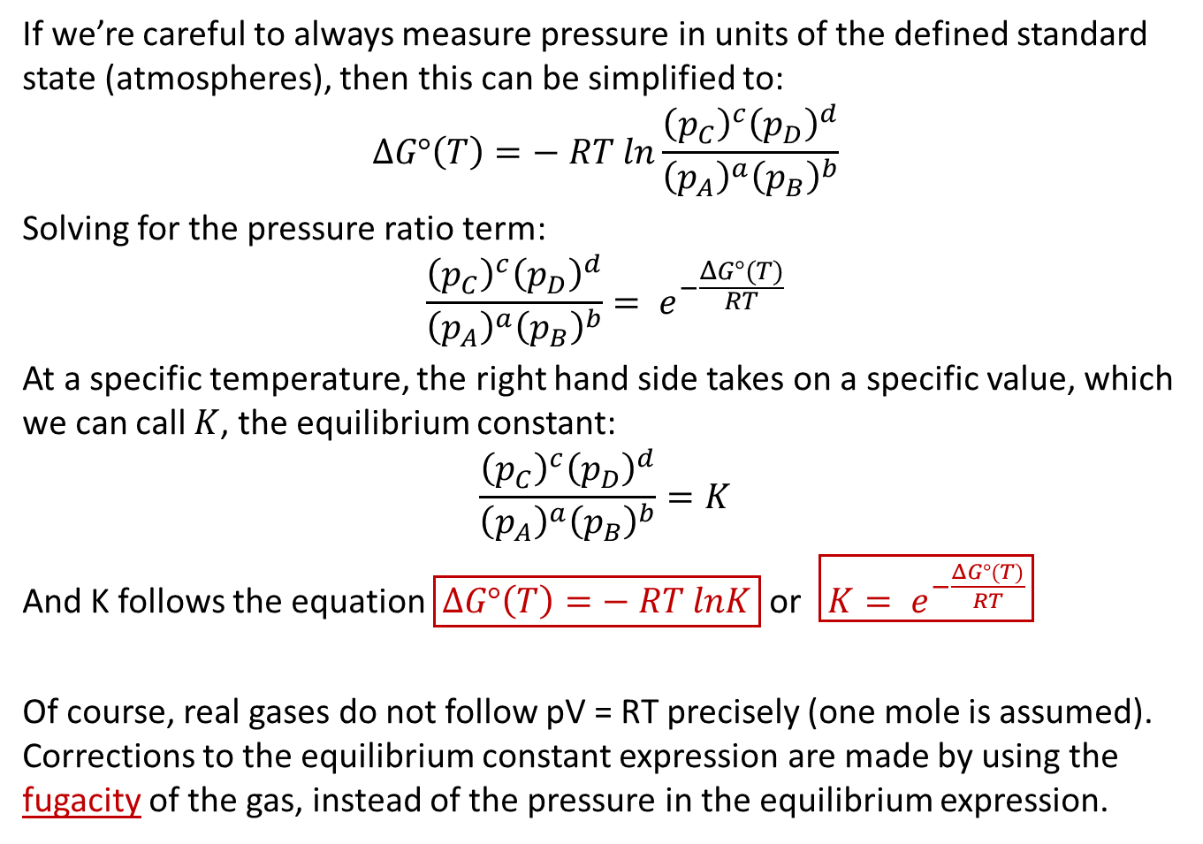
The equilibrium constant, K
If we’re careful to always measure pressure in units of the defined standard state (atmospheres), then this can be simplified to:
$$ΔG°\left(T\right)=− RT ln\frac{{\left(p_{C}\right)}^{c}{\left(p_{D}\right)}^{d}}{{\left(p_{A}\right)}^{a}{\left(p_{B}\right)}^{b}}$$
Solving for the pressure ratio term:
$$\frac{{\left(p_{C}\right)}^{c}{\left(p_{D}\right)}^{d}}{{\left(p_{A}\right)}^{a}{\left(p_{B}\right)}^{b}}= e^{−\frac{ΔG°(T)}{RT}}$$
At a specific temperature, the right hand side takes on a specific value, which we can call $K$, the equilibrium constant:
$$\frac{{\left(p_{C}\right)}^{c}{\left(p_{D}\right)}^{d}}{{\left(p_{A}\right)}^{a}{\left(p_{B}\right)}^{b}}=K$$
And K follows the equation $\boxed{ΔG°\left(T\right)=− RT lnK}$ or $\boxed{K= e^{−\frac{ΔG°(T)}{RT}}}$
Of course, real gases do not follow pV = RT precisely (one mole is assumed). Corrections to the equilibrium constant expression are made by using the fugacity of the gas, instead of the pressure in the equilibrium expression.

Slide 10
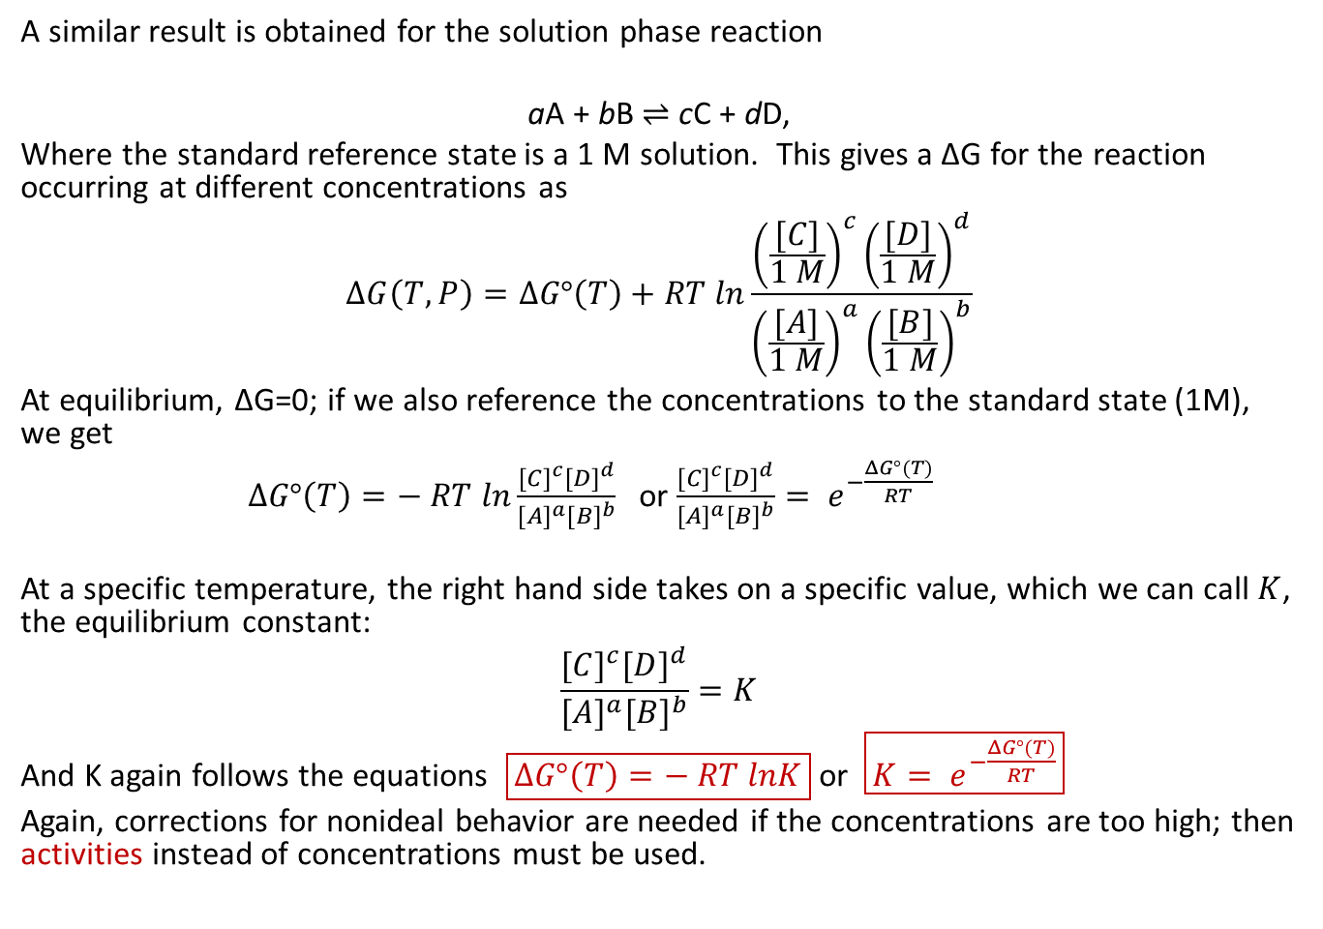
Solutions
A similar result is obtained for the solution phase reaction
aA + bB $⇌$ cC + dD,
Where the standard reference state is a 1 M solution. This gives a ΔG for the reaction occurring at different concentrations as
$$ΔG\left(T,P\right)=ΔG°\left(T\right)+RT ln\frac{{\left(\frac{[C]}{1 M}\right)}^{c}{\left(\frac{[D]}{1 M}\right)}^{d}}{{\left(\frac{[A]}{1 M}\right)}^{a}{\left(\frac{[B]}{1 M}\right)}^{b}}$$
At equilibrium, ΔG=0; if we also reference the concentrations to the standard state (1M), we get
$ΔG°\left(T\right)=− RT ln\frac{{[C]}^{c}{[D]}^{d}}{{[A]}^{a}{[B]}^{b}}$ or $\frac{{[C]}^{c}{[D]}^{d}}{{[A]}^{a}{[B]}^{b}}= e^{−\frac{ΔG°(T)}{RT}}$
At a specific temperature, the right hand side takes on a specific value, which we can call $K$, the equilibrium constant:
$$\frac{{[C]}^{c}{[D]}^{d}}{{[A]}^{a}{[B]}^{b}}=K$$
And K again follows the equations $\boxed{ΔG°\left(T\right)=− RT lnK}$ or $\boxed{K= e^{−\frac{ΔG°(T)}{RT}}}$
Again, corrections for nonideal behavior are needed if the concentrations are too high; then activities instead of concentrations must be used.

Slide 11
What’s the Point?
Equilibrium and equilibrium constants come from thermodynamics – NOT from kinetics.
In some cases (beyond AP Chemistry) it may be necessary to correct gas pressures to fugacities and solution concentrations to activities to obtain valid results.

Slide 12
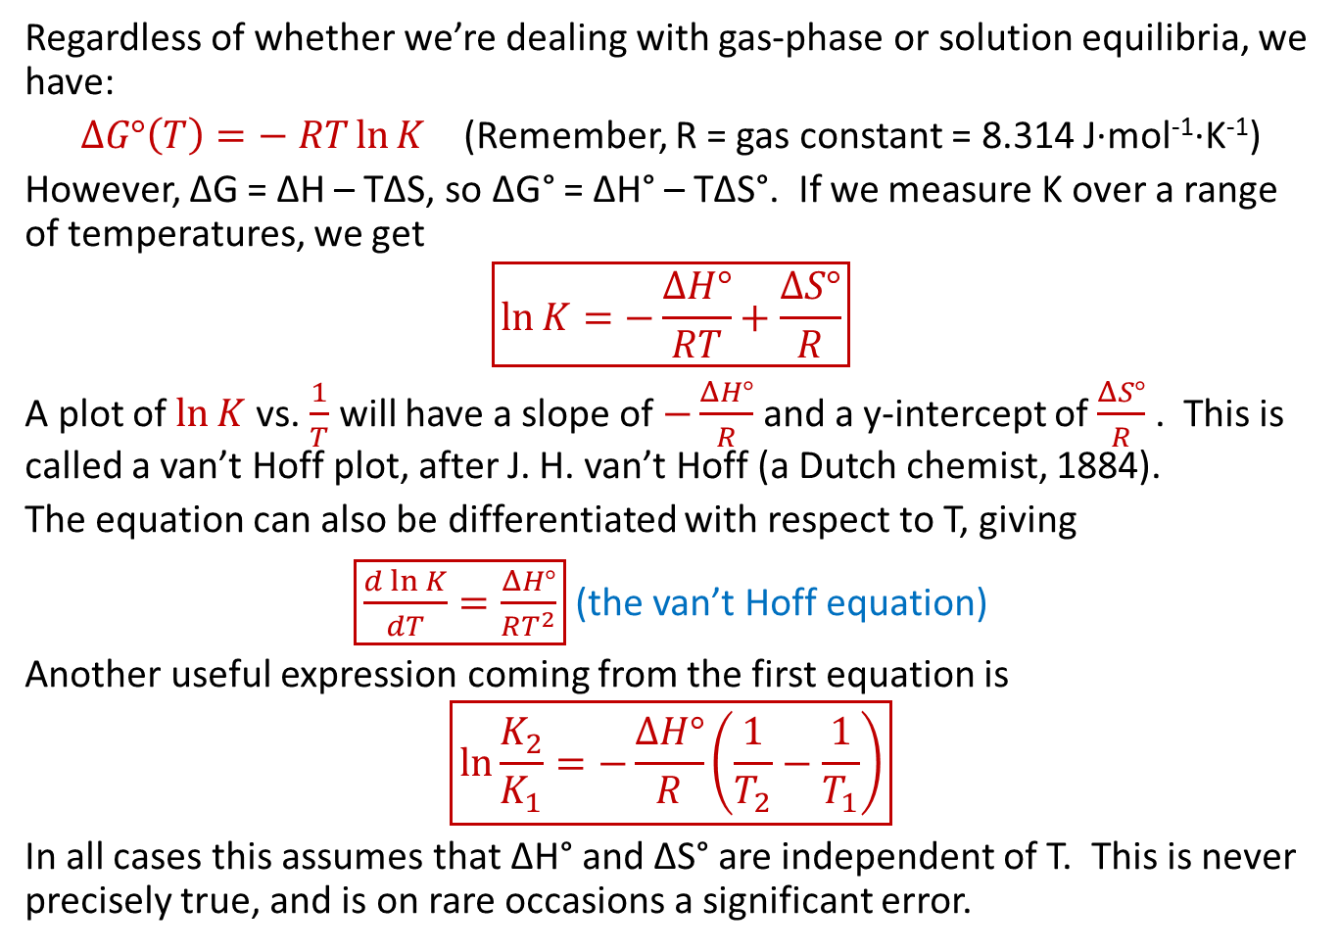
Temperature Dependence
Regardless of whether we’re dealing with gas-phase or solution equilibria, we have:
$ΔG°\left(T\right)=− RT\ln{K}$ (Remember, R = gas constant = 8.314 J·mol⁻¹·K⁻¹)
However, ΔG = ΔH – TΔS, so ΔG° = ΔH° – TΔS°. If we measure K over a range of temperatures, we get
$$\boxed{\ln{K}=−\frac{ΔH°}{RT}+\frac{ΔS°}{R}}$$
A plot of $\ln{K}$ vs. $\frac{1}{T}$ will have a slope of $−\frac{ΔH°}{R}$ and a y-intercept of $\frac{ΔS°}{R}$ . This is called a van’t Hoff plot, after J. H. van’t Hoff (a Dutch chemist, 1884).
The equation can also be differentiated with respect to T, giving
$\boxed{\frac{d\ln{K}}{dT}=\frac{ΔH°}{RT^{2}}}$ (the van’t Hoff equation)
Another useful expression coming from the first equation is
$$\boxed{\ln{\frac{K_{2}}{K_{1}}}=−\frac{ΔH°}{R}\left(\frac{1}{T_{2}}−\frac{1}{T_{1}}\right)}$$
In all cases this assumes that ΔH° and ΔS° are independent of T. This is never precisely true, and is on rare occasions a significant error.

Slide 13
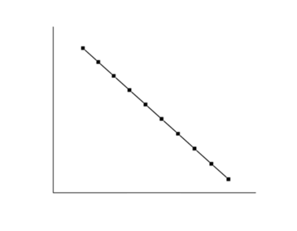
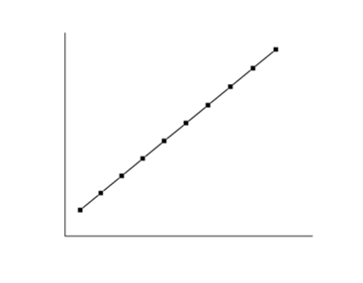



Examples of van’t Hoff plots
Endothermic Reaction (ΔH > 0) Exothermic Reaction (ΔH < 0)
Slope = $−\frac{ΔH°}{R}$
Slope = $−\frac{ΔH°}{R}$
ln K
ln K
y-intercept = $\frac{ΔS°}{R}$
y-intercept = $\frac{ΔS°}{R}$
1/T (1/K) 1/T (1/K)
From: https://en.wikipedia.org/wiki/Van_%27t_Hoff_equation
A common mistake: Failure to measure T in Kelvins!

Slide 14
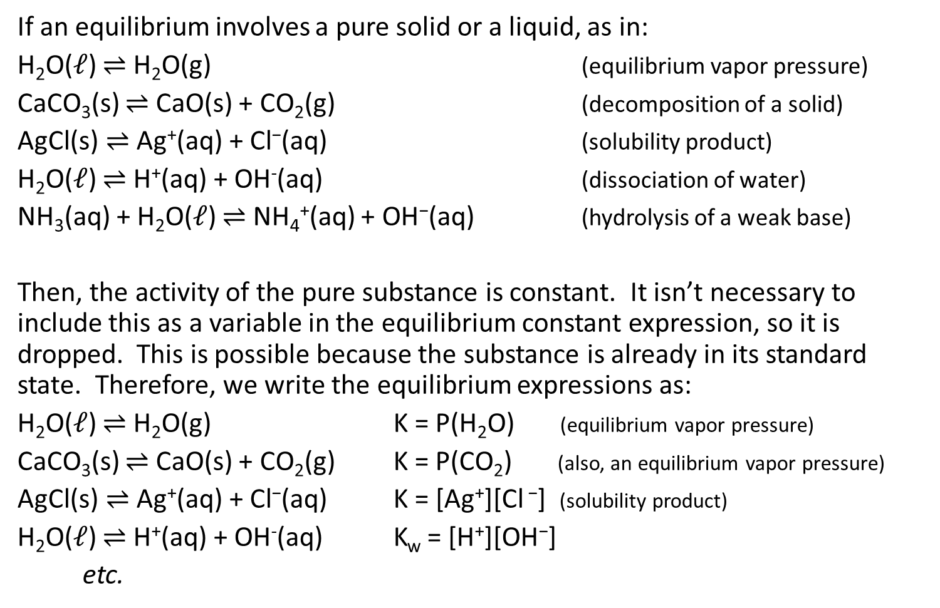
A note on solids and liquids
If an equilibrium involves a pure solid or a liquid, as in:
H₂O($ℓ$) $⇌$ H₂O(g) (equilibrium vapor pressure)
CaCO₃(s) $⇌$ CaO(s) + CO₂(g) (decomposition of a solid)
$\text{AgCl}\text{(}\text{s}\text{)}⇌$ $\text{Ag}\text{+}\text{(}\text{aq}\text{) + }\text{Cl}\text{−}\text{(}\text{aq}\text{)}$ (solubility product)
H₂O($ℓ$) $⇌$ H⁺(aq) + OH⁻(aq) (dissociation of water)
NH₃(aq) + H₂O($ℓ$) $⇌$ NH₄⁺(aq) + OH$\text{−}$(aq) (hydrolysis of a weak base)
Then, the activity of the pure substance is constant. It isn’t necessary to include this as a variable in the equilibrium constant expression, so it is dropped. This is possible because the substance is already in its standard state. Therefore, we write the equilibrium expressions as:
H₂O($ℓ$) $⇌$ H₂O(g) K = P(H₂O) (equilibrium vapor pressure)
CaCO₃(s) $⇌$ CaO(s) + CO₂(g) K = P(CO₂) (also, an equilibrium vapor pressure)
$\text{AgCl}\text{(}\text{s}\text{)}⇌$ $\text{Ag}\text{+}\text{(}\text{aq}\text{) + }\text{Cl}\text{−}\text{(}\text{aq}\text{)}$ K = [Ag⁺][Cl $\text{−}$] (solubility product)
H₂O($ℓ$) $⇌$ H⁺(aq) + OH⁻(aq) K_{w} = [H⁺][OH$\text{−}$]
etc.

Slide 15
Now, let’s solve some problems!

Slide 16

The Haber synthesis of NH₃
For the reaction N₂(g) + 3H₂(g) $⇌$ 2NH₃(g), K_{p} = 1.45 × 10⁻⁵ at 500°C.
If an equilibrium mixture at this temperature has partial pressures of 0.928 atm for H₂ and 0.432 atm for N₂, what is the partial pressure of NH₃ in the mixture?

Slide 17
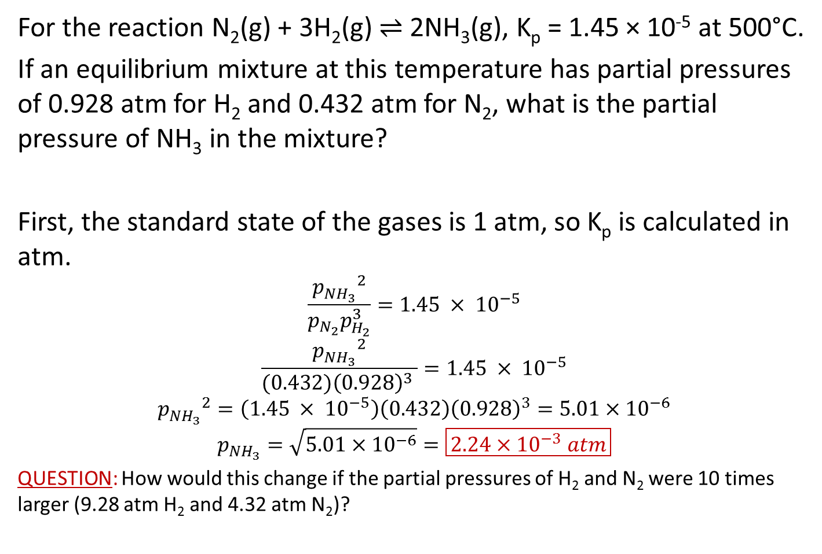
The Haber synthesis of NH₃
For the reaction N₂(g) + 3H₂(g) $⇌$ 2NH₃(g), K_{p} = 1.45 × 10⁻⁵ at 500°C.
If an equilibrium mixture at this temperature has partial pressures of 0.928 atm for H₂ and 0.432 atm for N₂, what is the partial pressure of NH₃ in the mixture?
First, the standard state of the gases is 1 atm, so K_{p} is calculated in atm.
$$\frac{{p_{{NH}_{3}}^{}}^{2}}{p_{N_{2}}p_{H_{2}}^{3}}=1.45 × {10}^{−5}$$
$$\frac{{p_{{NH}_{3}}^{}}^{2}}{(0.432){\left(0.928\right)}^{3} }=1.45 × {10}^{−5}$$
$${p_{{NH}_{3}}^{}}^{2}=\left(1.45 × {10}^{−5}\right)\left(0.432\right){\left(0.928\right)}^{3}=5.01×{10}^{−6}$$
$$p_{{NH}_{3}}=\sqrt{5.01×{10}^{−6}}=\boxed{2.24×{10}^{−3} atm}$$
QUESTION: How would this change if the partial pressures of H₂ and N₂ were 10 times larger (9.28 atm H₂ and 4.32 atm N₂)?

Slide 18

The Haber synthesis of NH₃
QUESTION: How would this change if the partial pressures of H₂ and N₂ were 10 times larger (9.28 atm H₂ and 4.32 atm N₂)?
ANSWER: Since both were multiplied by 10, the denominator is multiplied by 10⁴. The numerator must also be multiplied by 10⁴, so $p_{{NH}_{3}}$ must be multiplied by 10², giving
$$p_{{NH}_{3}}=\boxed{2.24×{10}^{−3}atm×10^{2}=0.224 atm}$$

Slide 19
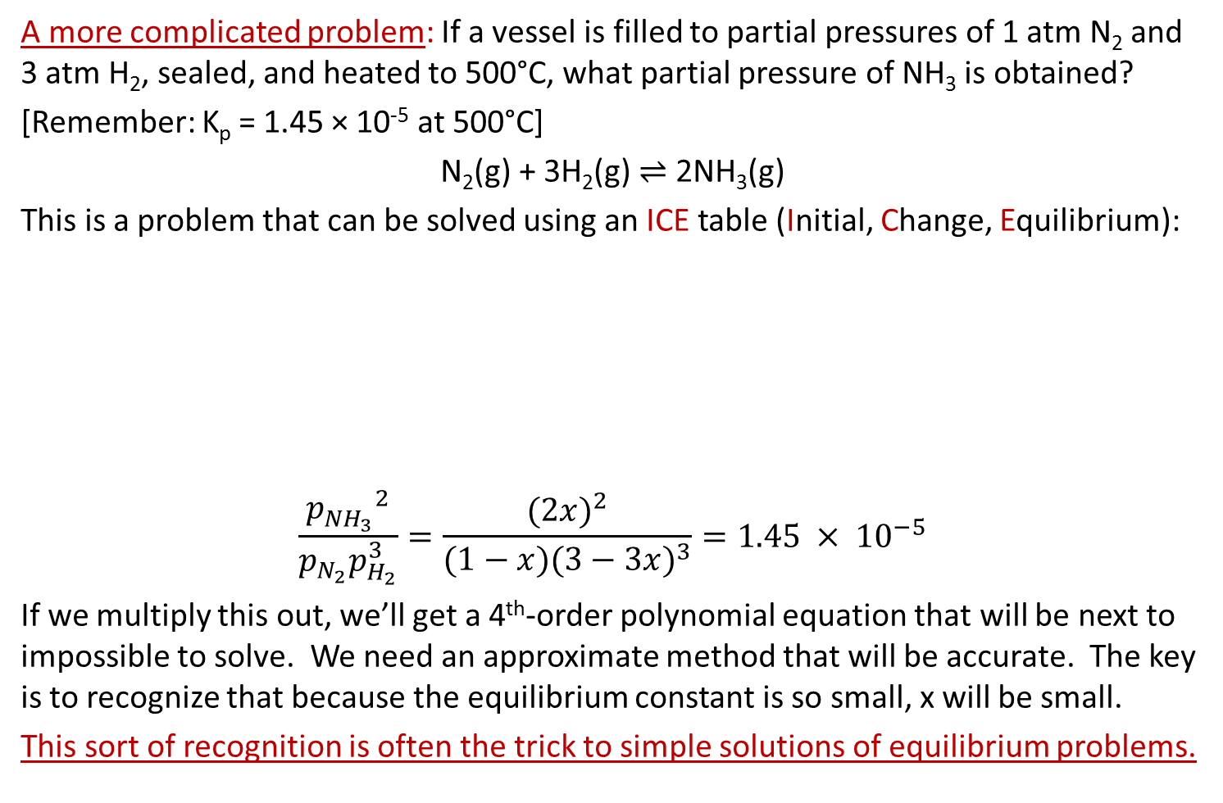
The Haber synthesis of NH₃
A more complicated problem: If a vessel is filled to partial pressures of 1 atm N₂ and 3 atm H₂, sealed, and heated to 500°C, what partial pressure of NH₃ is obtained?
[Remember: K_{p} = 1.45 × 10⁻⁵ at 500°C]
N₂(g) + 3H₂(g) $⇌$ 2NH₃(g)
This is a problem that can be solved using an ICE table (Initial, Change, Equilibrium):
$$\frac{{p_{{NH}_{3}}^{}}^{2}}{p_{N_{2}}p_{H_{2}}^{3}}=\frac{{(2x)}^{2}}{(1−x){(3−3x)}^{3}}=1.45 × {10}^{−5}$$
If we multiply this out, we’ll get a 4th-order polynomial equation that will be next to impossible to solve. We need an approximate method that will be accurate. The key is to recognize that because the equilibrium constant is so small, x will be small.
This sort of recognition is often the trick to simple solutions of equilibrium problems.
 | N₂ | H₂ | NH₃
Initial | 1 | 3 | 0
Change | -x | -3x | 2x
Equilibrium | 1-x | 3-3x | 2x

Slide 20
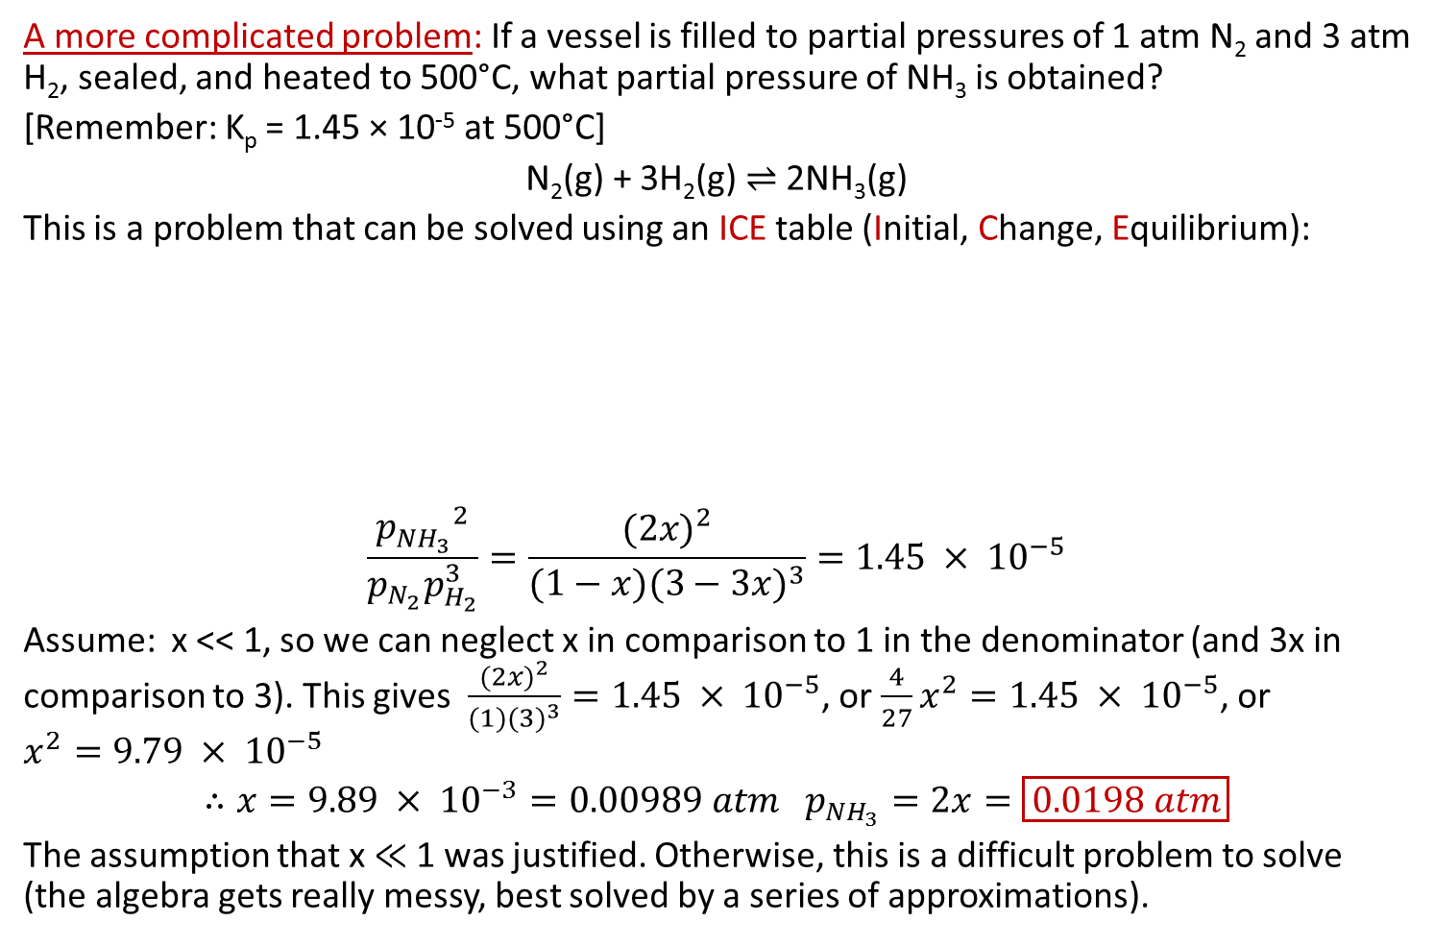
The Haber synthesis of NH₃
A more complicated problem: If a vessel is filled to partial pressures of 1 atm N₂ and 3 atm H₂, sealed, and heated to 500°C, what partial pressure of NH₃ is obtained?
[Remember: K_{p} = 1.45 × 10⁻⁵ at 500°C]
N₂(g) + 3H₂(g) $⇌$ 2NH₃(g)
This is a problem that can be solved using an ICE table (Initial, Change, Equilibrium):
$$\frac{{p_{{NH}_{3}}^{}}^{2}}{p_{N_{2}}p_{H_{2}}^{3}}=\frac{{(2x)}^{2}}{(1−x){(3−3x)}^{3}}=1.45 × {10}^{−5}$$
Assume: x << 1, so we can neglect x in comparison to 1 in the denominator (and 3x in comparison to 3). This gives $\frac{{(2x)}^{2}}{(1){(3)}^{3}}=1.45 × {10}^{−5}$, or $\frac{4}{27}x^{2}=1.45 × {10}^{−5}$, or $x^{2}=9.79 × {10}^{−5}$
$$∴x=9.89 × {10}^{−3}=0.00989 atm p_{{NH}_{3}}=2x=\boxed{0.0198 atm}$$
The assumption that x $≪$ 1 was justified. Otherwise, this is a difficult problem to solve (the algebra gets really messy, best solved by a series of approximations).
 | N₂ | H₂ | NH₃
Initial | 1 | 3 | 0
Change | -x | -3x | 2x
Equilibrium | 1-x | 3-3x | 2x

Slide 21
The Haber synthesis of NH₃
Yet another kind of problem: If a vessel is filled to partial pressures of 10.0 atm N₂,
30.0 atm H₂, and 5.00 atm NH₃ sealed, and equilibrated at 500°C, will the partial pressure of NH₃ rise or fall?

Slide 22
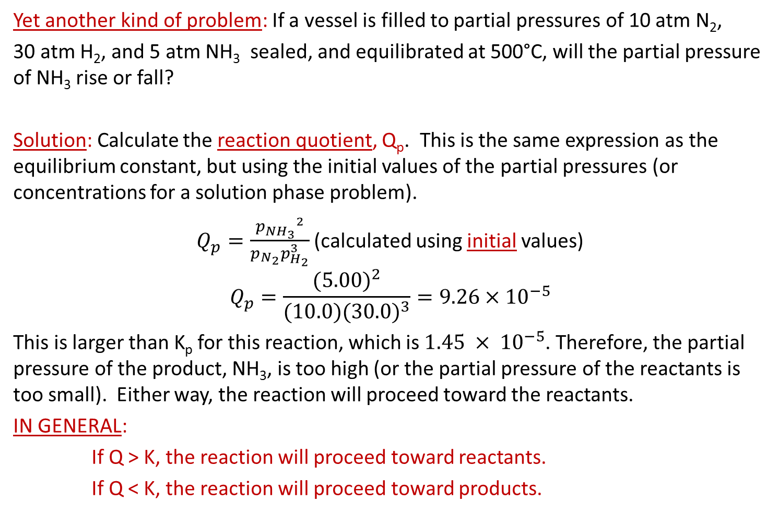
The Haber synthesis of NH₃
Yet another kind of problem: If a vessel is filled to partial pressures of 10 atm N₂,
30 atm H₂, and 5 atm NH₃ sealed, and equilibrated at 500°C, will the partial pressure of NH₃ rise or fall?
Solution: Calculate the reaction quotient, Q_{p}. This is the same expression as the equilibrium constant, but using the initial values of the partial pressures (or concentrations for a solution phase problem).
$Q_{p}=\frac{{p_{{NH}_{3}}^{}}^{2}}{p_{N_{2}}p_{H_{2}}^{3}}$ (calculated using initial values)
$$Q_{p}=\frac{{(5.00)}^{2}}{(10.0){(30.0)}^{3}}=9.26×{10}^{−5}$$
This is larger than K_{p} for this reaction, which is $1.45 × {10}^{−5}$. Therefore, the partial pressure of the product, NH₃, is too high (or the partial pressure of the reactants is too small). Either way, the reaction will proceed toward the reactants.
IN GENERAL:
If Q > K, the reaction will proceed toward reactants.
If Q < K, the reaction will proceed toward products.

Slide 23

Solubility Products
Many sparingly soluble salts exist, for which the equilibrium constant is of the form:
AgCl(s) $⇌$ Ag⁺(aq) + Cl–(aq) K_{sp} = [Ag⁺][Cl–]= 1.7 × 10⁻¹⁰
QUESTION: If 10.0g of AgCl are added to 1.00 L of pure water, how many grams will dissolve?

Slide 24
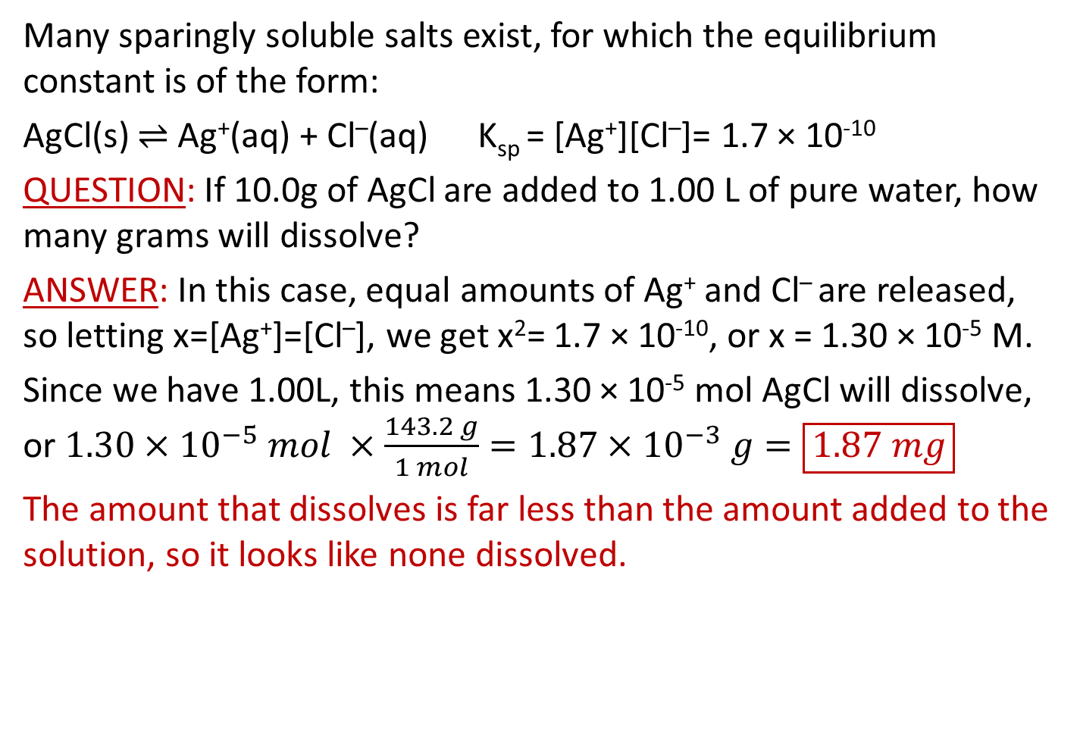
Solubility Products
Many sparingly soluble salts exist, for which the equilibrium constant is of the form:
AgCl(s) $⇌$ Ag⁺(aq) + Cl–(aq) K_{sp} = [Ag⁺][Cl–]= 1.7 × 10⁻¹⁰
QUESTION: If 10.0g of AgCl are added to 1.00 L of pure water, how many grams will dissolve?
ANSWER: In this case, equal amounts of Ag⁺ and Cl– are released, so letting x=[Ag⁺]=[Cl–], we get x²= 1.7 × 10⁻¹⁰, or x = 1.30 × 10⁻⁵ M.
Since we have 1.00L, this means 1.30 × 10⁻⁵ mol AgCl will dissolve, or $1.30×{10}^{−5} mol ×\frac{143.2 g}{1 mol}=1.87×{10}^{−3} g=\boxed{1.87 mg}$
The amount that dissolves is far less than the amount added to the solution, so it looks like none dissolved.

Slide 25

Solubility Products
AgCl(s) $⇌$ Ag⁺(aq) + Cl–(aq) K_{sp} = [Ag⁺][Cl–]= 1.7 × 10⁻¹⁰
A bit trickier question: If 10.0g of AgCl are added to 1.00 L of a
1.00 mM NaCl solution, how many grams will dissolve?
First: Will the amount that dissolves be greater than or less than the amount that dissolved in pure water?

Slide 26
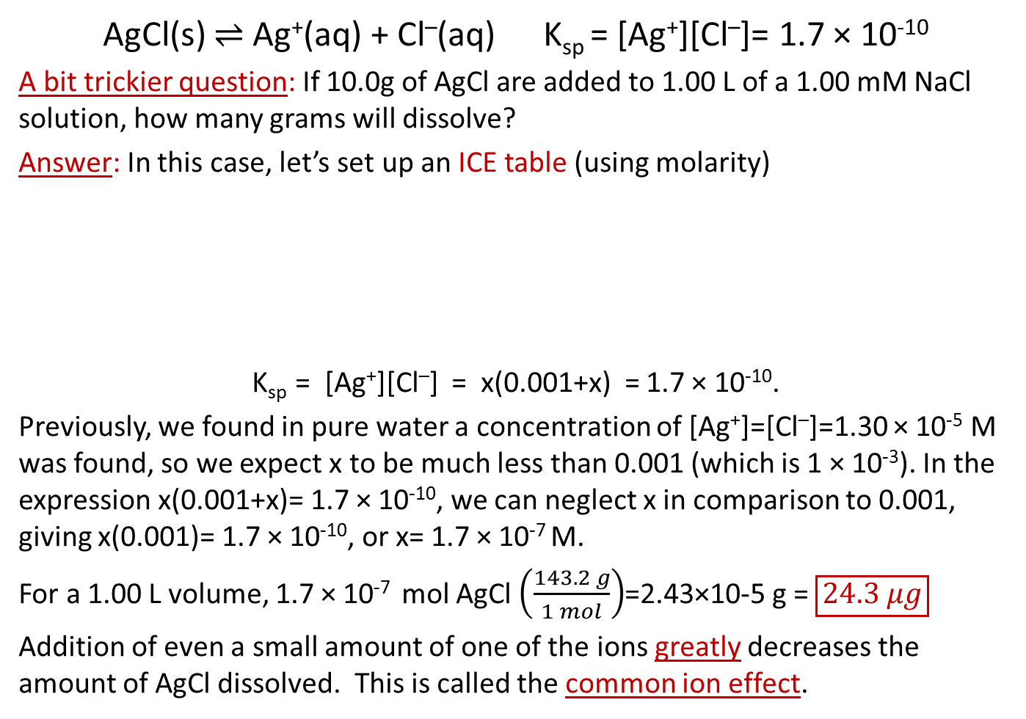
Solubility Products
AgCl(s) $⇌$ Ag⁺(aq) + Cl–(aq) K_{sp} = [Ag⁺][Cl–]= 1.7 × 10⁻¹⁰
A bit trickier question: If 10.0g of AgCl are added to 1.00 L of a 1.00 mM NaCl solution, how many grams will dissolve?
Answer: In this case, let’s set up an ICE table (using molarity)
K_{sp} = [Ag⁺][Cl–] = x(0.001+x) = 1.7 × 10⁻¹⁰.
Previously, we found in pure water a concentration of [Ag⁺]=[Cl–]=1.30 × 10⁻⁵ M was found, so we expect x to be much less than 0.001 (which is 1 × 10⁻³). In the expression x(0.001+x)= 1.7 × 10⁻¹⁰, we can neglect x in comparison to 0.001, giving x(0.001)= 1.7 × 10⁻¹⁰, or x= 1.7 × 10⁻⁷ M.
For a 1.00 L volume, 1.7 × 10⁻⁷ mol AgCl $\left(\frac{143.2 g}{1 mol}\right)$=2.43×10-5 g = $\boxed{24.3 μg}$
Addition of even a small amount of one of the ions greatly decreases the amount of AgCl dissolved. This is called the common ion effect.
 | Ag⁺ | Cl–
Initial | 0 | 0.001
Change | +x | +x
Equilibrium | x | 0.001+x

Slide 27
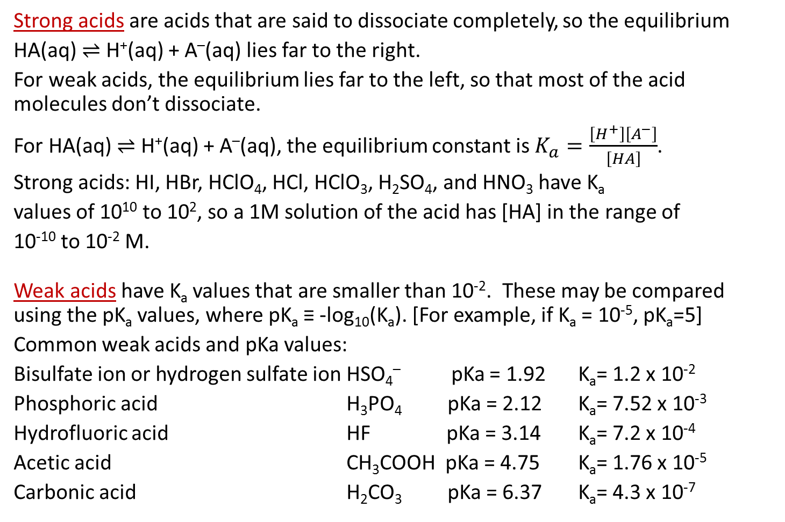
Weak acids
Strong acids are acids that are said to dissociate completely, so the equilibrium
HA(aq) $⇌$ H⁺(aq) + A–(aq) lies far to the right.
For weak acids, the equilibrium lies far to the left, so that most of the acid molecules don’t dissociate.
For HA(aq) $⇌$ H⁺(aq) + A–(aq), the equilibrium constant is $K_{a}=\frac{\left[H^{+}\right]\left[A^{−}\right]}{\left[HA\right]}$.
Strong acids: HI, HBr, HClO₄, HCl, HClO₃, H₂SO₄, and HNO₃ have K_{a}
values of 10¹⁰ to 10², so a 1M solution of the acid has [HA] in the range of
10⁻¹⁰ to 10⁻² M.
Weak acids have K_{a} values that are smaller than 10⁻². These may be compared using the pK_{a} values, where pK_{a} ≡ -log₁₀(K_{a}). [For example, if K_{a} = 10⁻⁵, pK_{a}=5]
Common weak acids and pKa values:
Bisulfate ion or hydrogen sulfate ion HSO₄– pKa = 1.92 K_{a}= 1.2 x 10⁻²
Phosphoric acid H₃PO₄ pKa = 2.12 K_{a}= 7.52 x 10⁻³
Hydrofluoric acid HF pKa = 3.14 K_{a}= 7.2 x 10⁻⁴
Acetic acid CH₃COOH pKa = 4.75 K_{a}= 1.76 x 10⁻⁵
Carbonic acid H₂CO₃ pKa = 6.37 K_{a}= 4.3 x 10⁻⁷

Slide 28
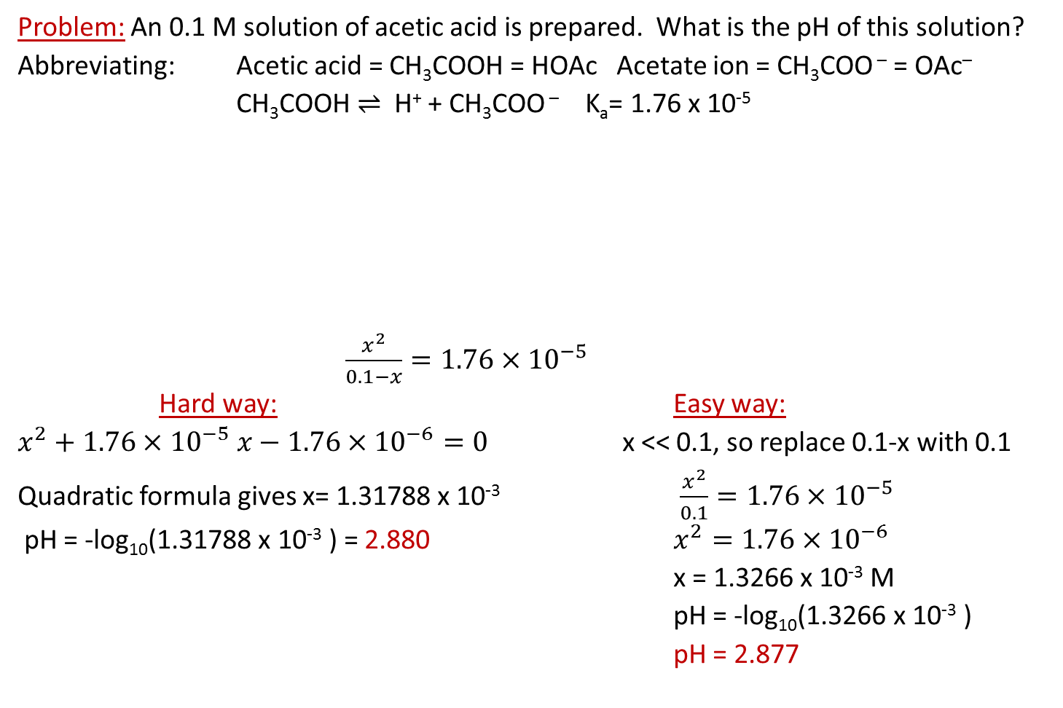
Weak acids
Problem: An 0.1 M solution of acetic acid is prepared. What is the pH of this solution?
Abbreviating: Acetic acid = CH₃COOH = HOAc Acetate ion = CH₃COO – = OAc–
CH₃COOH $⇌$ H⁺ + CH₃COO – K_{a}= 1.76 x 10⁻⁵
$\frac{x^{2}}{0.1−x}=1.76×{10}^{−5}$
Hard way: Easy way:
$x^{2}+1.76×{10}^{−5} x−1.76×{10}^{−6}=0$ x << 0.1, so replace 0.1-x with 0.1
Quadratic formula gives x= 1.31788 x 10⁻³ $\frac{x^{2}}{0.1}=1.76×{10}^{−5}$
pH = -log₁₀(1.31788 x 10⁻³ ) = 2.880 $x^{2}=1.76×{10}^{−6}$
x = 1.3266 x 10⁻³ M
pH = -log₁₀(1.3266 x 10⁻³ )
pH = 2.877
 | HOAc | H⁺ | OAc–
Initial | 0.1 | 0 | 0
Change | -x | x | X
Equilibrium | 0.1-x | x | X

Slide 29
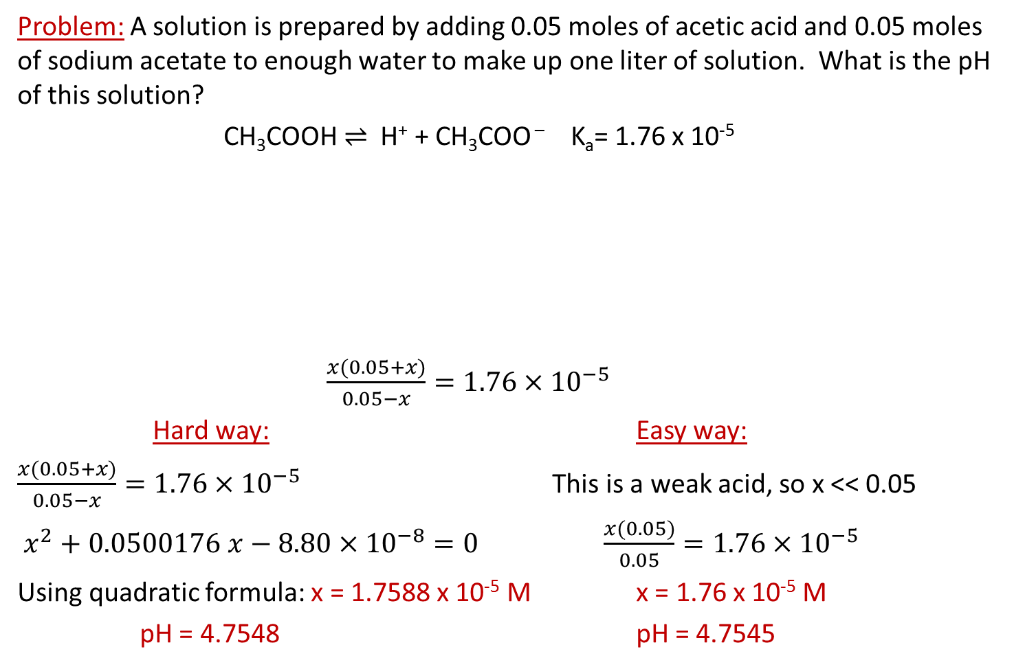
Weak acids
Problem: A solution is prepared by adding 0.05 moles of acetic acid and 0.05 moles of sodium acetate to enough water to make up one liter of solution. What is the pH of this solution?
CH₃COOH $⇌$ H⁺ + CH₃COO – K_{a}= 1.76 x 10⁻⁵
$\frac{x(0.05+x)}{0.05−x}=1.76×{10}^{−5}$
Hard way: Easy way:
$\frac{x(0.05+x)}{0.05−x}=1.76×{10}^{−5}$ This is a weak acid, so x << 0.05
$x^{2}+0.0500176 x−8.80×{10}^{−8}=0$ $\frac{x(0.05)}{0.05}=1.76×{10}^{−5}$
Using quadratic formula: x = 1.7588 x 10⁻⁵ M x = 1.76 x 10⁻⁵ M
pH = 4.7548 pH = 4.7545
 | HOAc | H⁺ | OAc–
Initial | 0.05 | 0 | 0.05
Change | -x | x | x
Equilibrium | 0.05-x | x | 0.05+x

Slide 30
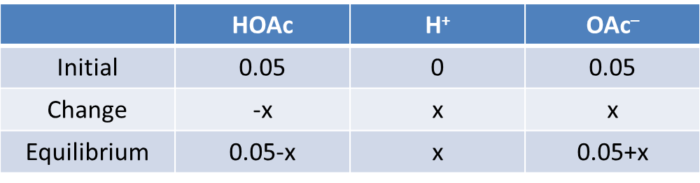
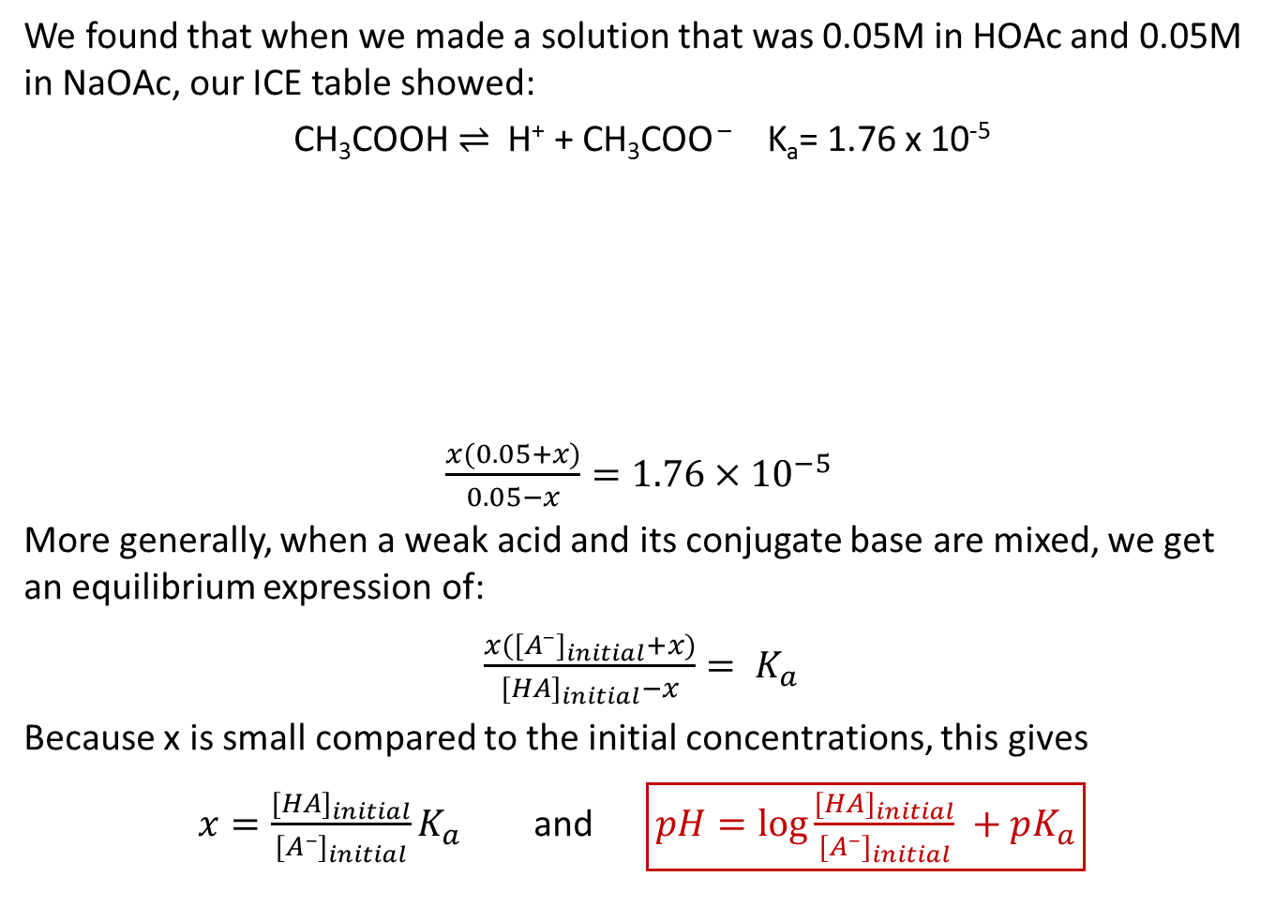
Buffer solutions
We found that when we made a solution that was 0.05M in HOAc and 0.05M in NaOAc, our ICE table showed:
CH₃COOH $⇌$ H⁺ + CH₃COO – K_{a}= 1.76 x 10⁻⁵
$\frac{x(0.05+x)}{0.05−x}=1.76×{10}^{−5}$
More generally, when a weak acid and its conjugate base are mixed, we get an equilibrium expression of:
$\frac{x([A^{–}]_{initial}+x)}{[HA]_{initial}−x}= K_{a}$
Because x is small compared to the initial concentrations, this gives
$x=\frac{[HA]_{initial}}{[A^{–}]_{initial}}K_{a}$ and $\boxed{pH=\log{\frac{[HA]_{initial}}{[A^{–}]_{initial}}} +pK_{a}}$

Slide 31
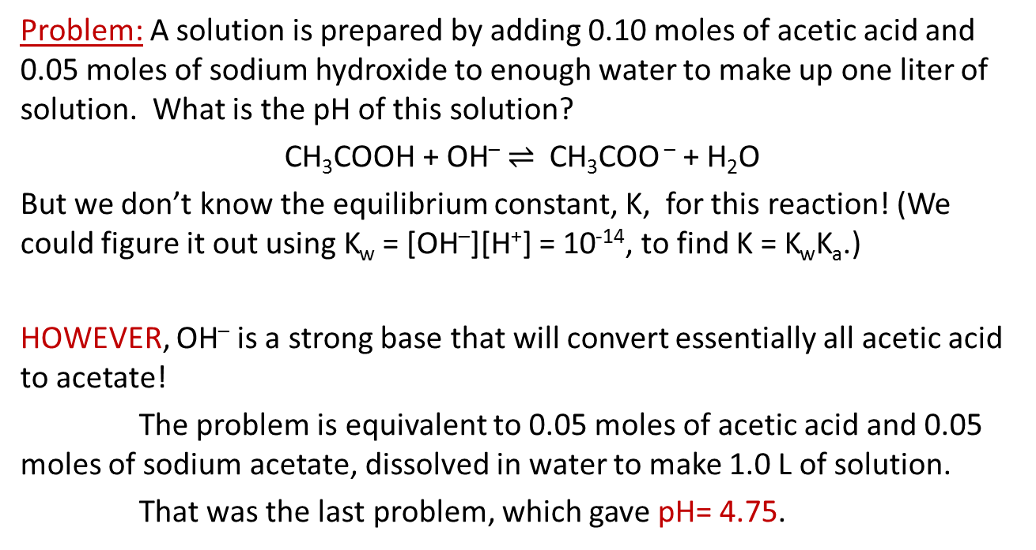
Simplify equilibrium problems by finding equivalent systems
Problem: A solution is prepared by adding 0.10 moles of acetic acid and 0.05 moles of sodium hydroxide to enough water to make up one liter of solution. What is the pH of this solution?
CH₃COOH + OH– $⇌$ CH₃COO – + H₂O
But we don’t know the equilibrium constant, K, for this reaction! (We could figure it out using K_{w} = [OH–][H⁺] = 10⁻¹⁴, to find K = K_{w}K_{a}.)
HOWEVER, OH– is a strong base that will convert essentially all acetic acid to acetate!
The problem is equivalent to 0.05 moles of acetic acid and 0.05 moles of sodium acetate, dissolved in water to make 1.0 L of solution.
That was the last problem, which gave pH= 4.75.

Slide 32
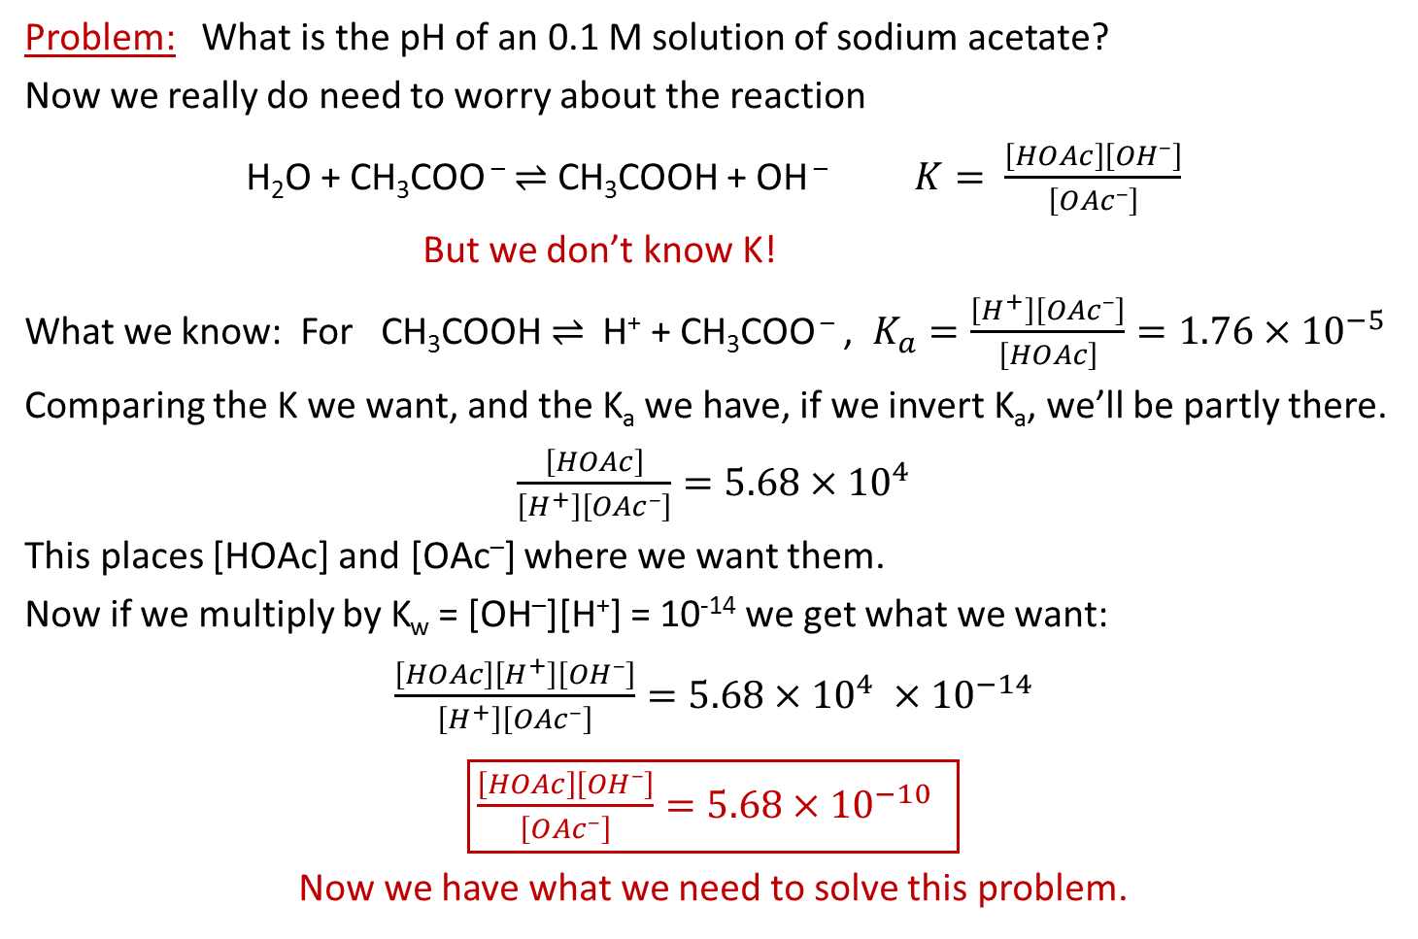
Weak acids
Problem: What is the pH of an 0.1 M solution of sodium acetate?
Now we really do need to worry about the reaction
H₂O + CH₃COO – $⇌$ CH₃COOH + OH – $K= \frac{\left[HOAc\right]\left[{OH}^{–}\right]}{\left[{OAc}^{–}\right]}$
But we don’t know K!
What we know: For CH₃COOH $⇌$ H⁺ + CH₃COO – , $K_{a}=\frac{\left[H^{+}\right]\left[{OAc}^{–}\right]}{\left[HOAc\right]}=1.76×{10}^{−5}$
Comparing the K we want, and the K_{a} we have, if we invert K_{a}, we’ll be partly there.
$\frac{\left[HOAc\right]}{\left[H^{+}\right]\left[{OAc}^{–}\right]}=5.68×{10}^{4}$
This places [HOAc] and [OAc–] where we want them.
Now if we multiply by K_{w} = [OH–][H⁺] = 10⁻¹⁴ we get what we want:
$\frac{\left[HOAc\right]\left[H^{+}\right]\left[{OH}^{–}\right]}{\left[H^{+}\right]\left[{OAc}^{–}\right]}=5.68×{10}^{4} ×{10}^{−14}$
$\boxed{\frac{\left[HOAc\right]\left[{OH}^{–}\right]}{\left[{OAc}^{–}\right]}=5.68×{10}^{−10} }$
Now we have what we need to solve this problem.

Slide 33
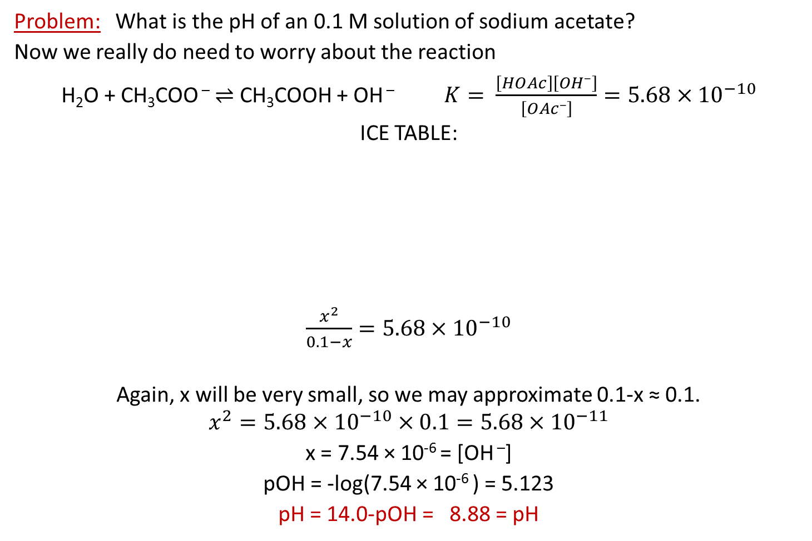
Weak acids
Problem: What is the pH of an 0.1 M solution of sodium acetate?
Now we really do need to worry about the reaction
H₂O + CH₃COO – $⇌$ CH₃COOH + OH – $K= \frac{\left[HOAc\right]\left[{OH}^{–}\right]}{\left[{OAc}^{–}\right]}=5.68×{10}^{−10}$
ICE TABLE:
$\frac{x^{2}}{0.1−x}=5.68×{10}^{−10}$
Again, x will be very small, so we may approximate 0.1-x ≈ 0.1.
$$x^{2}=5.68×{10}^{−10}×0.1=5.68×{10}^{−11}$$
x = 7.54 × 10⁻⁶ = [OH –]
pOH = -log(7.54 × 10⁻⁶ ) = 5.123
pH = 14.0-pOH = 8.88 = pH
 | CH₃COO – | CH₃COOH | OH –
Initial | 0.1 | 0 | 0
Change | -x | x | x
Equilibrium | 0.1-x | x | x

Slide 34
The following reaction has K = 2. Which image shows the reaction at equilibrium?

