Slide 1
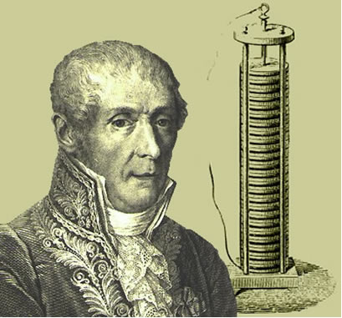
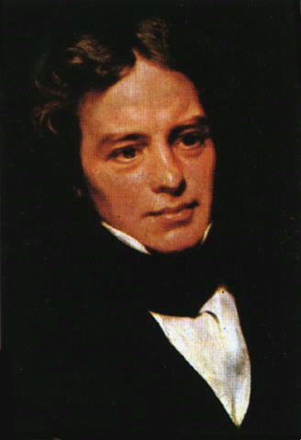
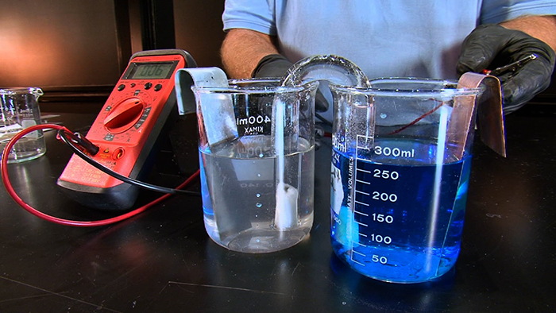
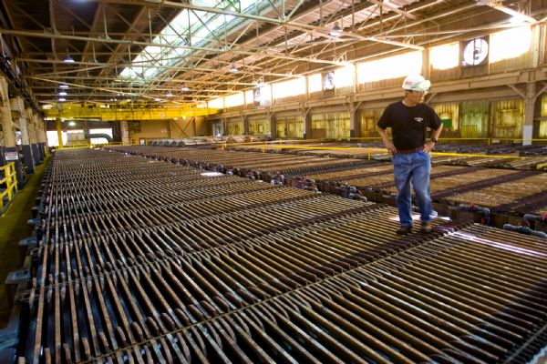
Electrochemistry
Michael Morse
Alessandro Volta Michael Faraday Walther Nerst

Slide 2
Electrochemistry
Using electrical potentials and currents as a way to affect chemistry
Using chemistry to generate electrical potentials and currents
Using electrical potentials and currents as a way to study chemical phenomena
In all of these uses, the key is to control or use oxidation-reduction chemistry by either supplying the electrons through wires, or getting the chemistry to deliver the electrons through wires.

Slide 3
Oxidation-Reduction Reactions (or REDOX reactions)
The starting point for all of electrochemistry is the idea of oxidation-reduction reactions.
One reactant loses electrons (is oxidized), for example:
Zn → Zn²⁺ + 2e⁻
The other reactant gains electrons (is reduced), for example:
Ag⁺ + e⁻→ Ag
Here, Ag⁺ causes Zn to be oxidized, so it is the oxidizing agent.
Zn causes Ag⁺ to be reduced, so it is the reducing agent.
The key to electrochemistry is separating the two reactions so that they can be driven by supplying or removing electrons at an electrode. Alternatively, by forcing the electrons to run through a circuit, chemical energy can be converted into electrical energy, which can be used to perform work (a battery).

Slide 4
Balancing REDOX reactions
The key thing is to write the two half-reactions so that the number of electrons that move is the same for both of them. In this example, it is trivial.
Zn → Zn²⁺ + 2e⁻ Two electrons move
Ag⁺ + e⁻→ Ag One electron moves
Obviously, the second half-reaction must be multiplied by 2:
Zn → Zn²⁺ + 2e⁻ Two electrons move
2Ag⁺ + 2e⁻→ 2Ag Two electron moves
Add the two equations, deleting species that appear as reactants and products (the 2 electrons here), and we get a balanced reaction.
Zn + 2Ag⁺ → Zn²⁺ + 2Ag
These can get a lot more complicated, especially for reactions that occur in acidic or basic solutions.

Slide 5
First a bit about oxidation numbers:
Oxidation numbers are a way of assigning electrons to atoms, but they’re really just a bookkeeping device. In HI, how can the shared electrons in the H-I covalent bond be distributed so that I has both of them and H has none? Still we always assign the oxidation numbers as H⁺¹ I⁻¹ in this compound.
Rules:
In any pure element, the oxidation number is 0.
The oxidation number of a monatomic ion is the charge of the ion.
The sum of all the oxidation numbers in a polyatomic ion or molecule is the net charge (0 if it is a neutral molecule).
In a compound, the oxidation number of an alkali metal is always +1; alkaline earths are always +2.
In a compound, fluorine is always -1; Cl, Br, and I are -1 unless in compounds with oxygen or fluorine.
The oxidation number of oxygen in a compound is -2, unless it is combined with fluorine or is a peroxide (in which case it is -1).
The oxidation number of hydrogen is +1, unless it is combined with a metal, in which case it is -1.

Slide 6
Balancing REDOX reactions in acidic media
First decide what is oxidized and reduced, then write balanced half-reactions.
Next, multiply the half-reactions by factors so the number of electrons lost equals the number gained, and combine the two half-reactions. Delete species that are replicated on both sides.
Next, determine which side has more oxygen atoms, and add water molecules to the other side so that the oxygen atoms are balanced.
Finally, determine which side has more hydrogen atoms, and add H⁺ ions to the other side so the hydrogens are balanced.
Check to make sure the number of atoms of each element, and the net charge on each side balances, and you’re done.

Slide 7
Example: A REDOX reaction in acidic media
Cu(s) + HNO₃(aq) → Cu(NO₃)₂ (aq) + NO(g)
Oxidation #s: 0 +1 +5 -2 +2 +5 -2 +2 -2
Cu is oxidized: Cu(s) → Cu²⁺ (aq) + 2e⁻
N is reduced: HNO₃(aq) +3H⁺(aq) + 3e⁻ → NO(g) + 2H₂O(l)
Multiply by 3 and 2, respectively, so 6e⁻ are exchanged:
3Cu(s) → 3Cu²⁺ (aq) + 6e⁻
2HNO₃(aq) +6H⁺(aq) + 6e⁻ → 2NO(g) + 4H₂O(l)
Add the half-reactions and delete replicated species (like 6e⁻):
3Cu(s)+ 2HNO₃(aq) +6H⁺(aq) → 3Cu²⁺ (aq) + 2NO(g) + 4H₂O(l)
This is already balanced, because I used the rules to balance the reduction half-reaction already.

Slide 8
Balancing REDOX reactions in basic media
First decide what is oxidized and reduced, then write balanced half-reactions.
Next, multiply the half-reactions by factors so the number of electrons lost equals the number gained, and combine the two half-reactions. Delete species that are replicated on both sides.
Next, determine which side has more oxygen atoms, and add 2OH⁻ per needed O atom to the side that needs O atoms, and add one H₂O per needed O atom to the side that has excess O atoms.
Check to make sure the number of atoms of each element, and the net charge on each side balances, and you’re done.

Slide 9
Example: A REDOX reaction in basic media
ClO⁻(aq) + I⁻(aq) → IO₃⁻ (aq) + Cl⁻(aq)
Oxidation #s: +1 -2 -1 +5 -2 -1
I is oxidized: I⁻(aq) → IO₃⁻ (aq) + 6e⁻
Cl is reduced: ClO⁻(aq) + 2e⁻ → Cl⁻(aq)
We can balance these half-reactions with regard to O and H atoms first or later. This time, I’ll balance them later.
Multiply the second reaction by 3, so 6e⁻ are exchanged:
I⁻(aq) → IO₃⁻ (aq) + 6e⁻
3ClO⁻(aq) + 6e⁻ → 3Cl⁻(aq)
Add these equations and delete replicated species (like 6e⁻):
I⁻(aq) + 3ClO⁻(aq) → IO₃⁻ (aq) + 3Cl⁻(aq)
It’s already balanced! No need to add OH⁻ or water.
Equivalently, I could have balanced each half-reaction first by addition OH⁻ and H₂O. For example, the I oxidation reaction has an excess of 3 O atoms on the right, so I need to add 6 OH⁻ ions on the left and 3 H₂O molecules on the right, to give:
6OH⁻ + I⁻(aq) → IO₃⁻ (aq) + 6e⁻ + 3H₂O(l) BALANCED!!

Slide 10
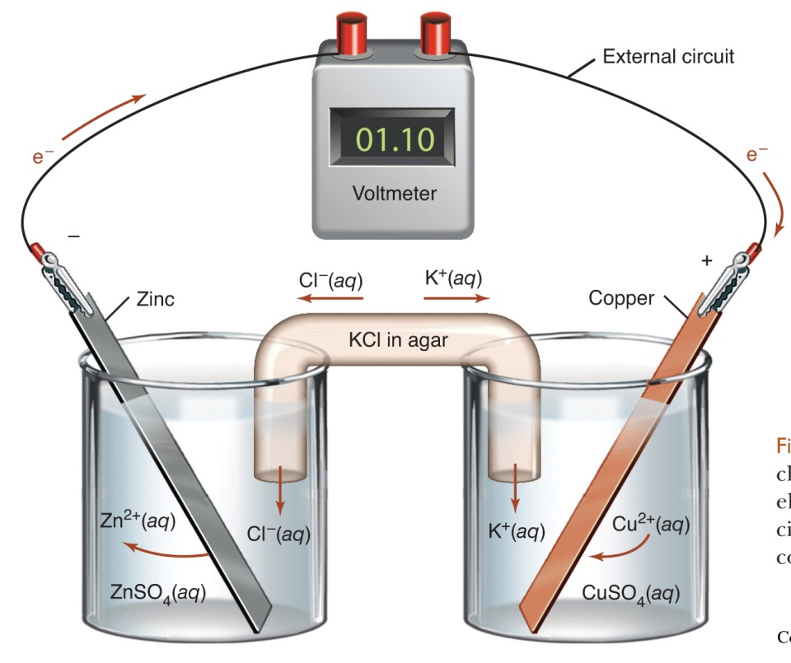
Faraday’s Law of Electrolysis
$$n=\frac{Q}{zF}$$
The number of moles of a substance produced or consumed at an electrode (n) equals the total charge that has flowed through the system (Q, in Coulombs), divided by the valency number of the ion (z, an integer) times a constant, F.
F is now called the Faraday constant:
F= 96,485 C/mol.
Now we would recognize z as the number of electrons transferred in order to cause the oxidation or reduction.
Ammeter
In this example, the number of moles of copper that are deposited on the copper electrode would be given by Q/2F because 2 electrons are required to reduce Cu²⁺ to Cu.
Question: At a current of 1 Ampere (1 Coulomb/sec), how long does it take to deposit 1 g of Cu onto a surface?

Slide 11
Faraday’s Law of Electrolysis
Question: At a current of 1 Ampere (1 Coulomb/sec), how long does it take to deposit 1 g of Cu onto a surface?
Solution:
First convert 1 g to moles: n= 1 g/(63.55 g/mol) = 0.01574 mol
Next, Q = 1 Ampere × t because Coulombs = Amperes × time (s).
z=2 because 2 electrons are required to reduce Cu²⁺(aq) to Cu(s).
Now, using $n=\frac{Q}{zF}$ we get
0.01574 mol = [(1 C/s) × t ]/ (2 × 96,485 C/mol)
$0.01574 mol= \frac{\left(1\frac{C}{s}\right)t}{2 ×96,485 C/mol}$
$0.01574 mol= \frac{\left(1\frac{C}{s}\right)t∙mol}{2 ×96,485 C}$
Solving for t:
$t=\left(0.01574 mol\right)×\left(2 ×96,485 C/mol\right)×\left(\frac{s}{1C}\right)=$ 3,036 s or 50.6 minutes
Follow-up question:
Kennecott produces 300,000 tons of copper/year. How many Coulombs of electrons do they require per year? [Answer: 8.3 × 10¹⁴ Coulombs or 5.16 × 10³³ electrons.]

Slide 12
Current vs. Voltage
Faraday’s Law – the total charge (or current integrated over time) governs how much material is oxidized or reduced.
For galvanic or voltaic cells, we’re concerned with voltage.
How can you understand the difference between current and voltage?
Current is easy – how many electrons pass a given point per second.
Voltage is related to the driving force that pushes the electrons to their destination. In electrochemistry, it is sometimes called the electromotive force (emf), measured in volts.

Slide 13
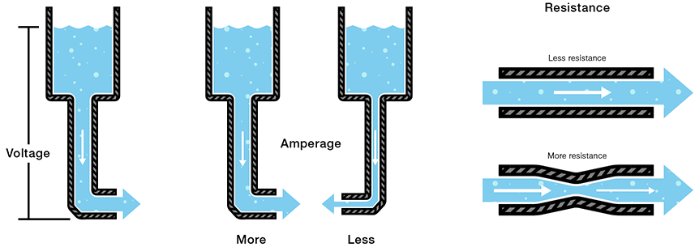
Current vs. Voltage
In fluid flow, the driving force is the pressure difference between the source and the sink.
In electricity, the driving force is the voltage difference between the electron source and sink.
In fluid flow, the current is how many liters of fluid flow past a point per second (L/s).
In electricity, the current is how many electrons flow past a point per second (C/s).
In both cases, there is resistance to flow, which slows the flow, takes some of the potential energy, and releases it as heat.

Slide 14
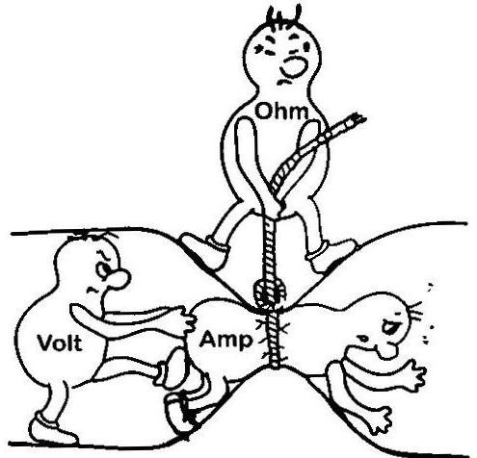
Current vs. Voltage
Potential Difference (V, volts) = Current (I, amps) × Resistance (R, ohms)
For a given potential difference, to increase current, you must decrease the resistance.

Slide 15
Galvanic or Voltaic Cells
A galvanic cell is a redox reaction, where the chemicals are separated in order to force the electrons to go through wires so they can do work.
Here, the two half-reactions:
Zn(s) → Zn²⁺(aq) + 2e⁻ (wire)
and
Cu²⁺(aq) + 2e⁻ (wire) → Cu(s)
supply a driving force of 1.10 V.
Cu²⁺ is removed from the right-hand beaker, so positive charge must be replenished.
Zn²⁺ is added to the left-hand beaker, so negative charge must be added to it.
This is done by the KCl salt bridge.
Otherwise, the cell shuts down.

Slide 16
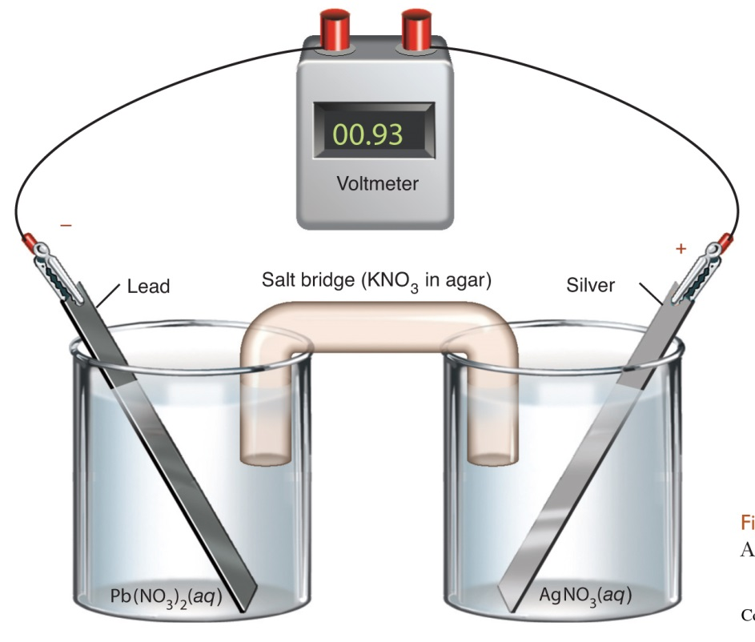
Galvanic or Voltaic Cells
Different metals produce different voltages:
Zn(s) → Zn²⁺(aq) + 2e⁻ (wire) Pb(s) → Pb²⁺(aq) + 2e⁻ (wire)
Cu²⁺(aq) + 2e⁻ (wire) → Cu(s) Ag⁺(aq) + e⁻ (wire) → Ag(s)
gives 1.10 V gives 0.93 V

Slide 17
Standard Reduction Potentials
Experiments show that the voltages produced by various pairs of metals are related:
Zn(s) → Zn²⁺(aq) + 2e⁻ (wire)
Cu²⁺(aq) + 2e⁻ (wire) → Cu(s) gives 1.10 V
Zn(s) → Zn²⁺(aq) + 2e⁻ (wire)
Ag⁺(aq) + e⁻ (wire) → Ag(s) gives 1.56 V
Cu(s) → Cu²⁺(aq) + 2e⁻ (wire)
Ag⁺(aq) + e⁻ (wire) → Ag(s) gives 0.46 V
This fits into a nice pattern if each half-reaction is assigned a standard reduction potential, $ℰ^{0}$:
Half-reaction $ℰ^{0}$ Cell Voltage
Cu²⁺(aq) + 2e⁻ → Cu(s) 0.337 V Ag/Cu 0.800 V - 0.337 V = 0.463 V
Ag⁺(aq) + e⁻ → Ag(s) 0.800 V Ag/Zn 0.800 V –(-0.762 V) = 1.562V
Zn²⁺(aq) + 2e⁻ → Zn(s) -0.762 V Cu/Zn 0.337 V – (-0.762 V) = 1.099 V
The voltage produced is just the standard reduction potential of the substance that is reduced minus the reduction potential of the substance being oxidized.

Slide 18
Standard Reduction Potentials
Signs matter! So it is good to have some conventions.
It turns out that $ℰ^{0}$ is related to thermodynamics (namely ∆G), so if we consider the actual reaction, we can combine the $ℰ^{0}$ values for the two half-reactions by writing them in opposite senses:
From the table of $ℰ^{0}$ values:
Cu²⁺(aq) + 2e⁻ → Cu(s) 0.337 V
Ag⁺(aq) + e⁻ → Ag(s) 0.800 V
Zn²⁺(aq) + 2e⁻ → Zn(s) -0.762 V
If we consider the cell
Zn(s) → Zn²⁺(aq) + 2e⁻ $ℰ^{0}$ = +0.762 V (reversed because we’ve reversed the reaction)
Cu²⁺(aq) + 2e⁻ → Cu(s) $ℰ^{0}$ = 0.337 V
Total voltage produced is the sum of that for the two half-reactions, 1.099 V
These two half-reactions produce a positive voltage difference, and the reactions do occur spontaneously in this direction, giving a negative ∆G.

Slide 19
Connection to ∆G
The free energy is the energy in a system that is available to do work.
For a system at constant pressure, the appropriate free energy is G, the Gibbs free energy, so we have:
-∆G = work that can be done by the system
If a charge (q, in Coulombs) is moved from a potential V₁ to V₂ (in volts), work is done on the charge in the amount q∆V = q $ℰ$.
So, we get
-∆G = q $ℰ$ (q is in Coulombs)
or
-∆G = nF $ℰ$ (n is the number of moles of electrons moved, F= 96,485 C/mol)
For example, for our electrochemical system: Zn(s) → Zn²⁺(aq) + 2e⁻
Cu²⁺(aq) + 2e⁻ → Cu(s)
we had a net $ℰ^{0}$ = 1.099 V
so ∆G°=-nF$ℰ^{0}$ = -(2 moles)(96,485 C/mol)(1.099 V) = -212,074 CV
But 1 Coulomb × 1 Volt = 1 Joule, so ∆G°=- 212,074 J = -212 kJ
The reaction Zn(s) + Cu²⁺(aq) → Cu(s) + Zn²⁺(aq) has ∆G°= -212 kJ/mol

Slide 20
Connection to ∆G
Electrochemistry can be used to determine equilibrium constants that are far beyond the range of direct measurement:
For Zn(s) + Cu²⁺(aq) → Cu(s) + Zn²⁺(aq), we’ve determined that ∆G°= -212 kJ/mol.
But we know that $ΔG°=− RT lnK$
So, using $K= e^{−\frac{ΔG°}{RT}}$ we get:
K = exp((212,000 J/mol)/(8.314 J/(mol-K) × 298K)) = exp(85.6) = 1.45 x 10³⁷
Good luck finding any Cu²⁺ ions in a beaker that contains a strip of zinc that has reached equilibrium!

Slide 21
The Nerst Equation
The tables of standard reduction potentials are listed based on the reactants and products being in the standard states (1 M concentrations). What if they aren’t?
We know how ∆G depends on concentration:
$$ΔG=ΔG°+RT ln\frac{{\left([C]\right)}^{c}{\left([D]\right)}^{d}}{{\left([A]\right)}^{a}{\left([B]\right)}^{b}}$$
Here, [C] and [D] are concentrations of products, [A] and [B] are concentrations of reactants
Because -∆G = nF $ℰ$, this gives
$$\frac{ΔG}{nF}=\frac{ΔG°}{nF}+\frac{RT}{nF} ln\frac{{\left([C]\right)}^{c}{\left([D]\right)}^{d}}{{\left([A]\right)}^{a}{\left([B]\right)}^{b}}$$
or
$$−\frac{ΔG}{nF}=−\frac{ΔG°}{nF}−\frac{RT}{nF} ln\frac{{\left([C]\right)}^{c}{\left([D]\right)}^{d}}{{\left([A]\right)}^{a}{\left([B]\right)}^{b}}$$
or
$$ℰ=ℰ^{0}−\frac{RT}{nF} ln\frac{{\left([C]\right)}^{c}{\left([D]\right)}^{d}}{{\left([A]\right)}^{a}{\left([B]\right)}^{b}}$$
At T = 298.15K = 25.00°C, $ℰ=ℰ^{0}−\frac{0.02569}{n} ln\frac{{\left(\left[C\right]\right)}^{c}{\left(\left[D\right]\right)}^{d}}{{\left(\left[A\right]\right)}^{a}{\left(\left[B\right]\right)}^{b}}$
$\boxed{ℰ=ℰ^{0}−\frac{0.05916}{n} log\frac{{\left([C]\right)}^{c}{\left([D]\right)}^{d}}{{\left([A]\right)}^{a}{\left([B]\right)}^{b}}}$ The Nernst Equation

Slide 22
The Nerst Equation
The Nernst Equation
$$ℰ=ℰ^{0}−\frac{0.05916}{n} log\frac{{\left([C]\right)}^{c}{\left([D]\right)}^{d}}{{\left([A]\right)}^{a}{\left([B]\right)}^{b}}$$
tells us how the voltage put out by a battery will change as it discharges, and the concentrations of products build up.
For example, if we start off with concentrations of 1 M Zn²⁺ and 1M Cu²⁺ in our cell:
Zn(s) → Zn²⁺(aq) + 2e⁻
Cu²⁺(aq) + 2e⁻ → Cu(s) or Zn(s) + Cu²⁺(aq) → Cu(s) + Zn²⁺(aq)
We get the standard $ℰ^{0}$ = 1.099 V.
When the cell has been half discharged, [Cu²⁺] = 0.5M. If the volume for the Zn²⁺ ions is the same as that for the Cu²⁺ ions, then [Zn²⁺] = 1.5M, and the cell will now generate a voltage difference of:
$$ℰ=1.099V−\frac{0.05916}{2} log\frac{\left[{Zn}^{2+}\right]}{\left[{Cu}^{2+}\right]}=1.099V−\frac{0.05916}{2} log\frac{1.5M}{0.5M}=\boxed{1.085 V}$$
What will the cell generate when it is 90% or 99% discharged?

Slide 23
A Conundrum
A Latimer diagram relates a series of oxidation states of an element:
IO₄⁻ IO₃⁻ HOI I₂ I⁻
⁽⁺⁷⁾ ⁽⁺⁵⁾ ⁽⁺¹⁾ ⁽⁰⁾ ⁽⁻¹⁾
The actual value is only 1.318 V!
+1.318V
+1.589V +1.154V +1.430 V +0.535 V
+1.210V
Why doesn’t the $ℰ^{0}$ value for IO₄⁻ → I₂ equal 1.589 V + 1.154 V + 1.430 V = 4.173 V ?

Slide 24
$ℰ^{0}$ Values Are Not Additive! (but ∆G values are)
A Latimer diagram relates a series of oxidation states of an element:
IO₄⁻ IO₃⁻ HOI I₂ I⁻
⁽⁺⁷⁾ ⁽⁺⁵⁾ ⁽⁺¹⁾ ⁽⁰⁾ ⁽⁻¹⁾
+1.318V
+1.589V +1.154V +1.430 V +0.535 V
+1.210V
Using ∆G = -nF$ℰ$, the IO₄⁻ I₂ reaction can be broken into 3 steps:
∆G₁ = -2F(1.589V)
∆G₂ = -4F(1.154V)
∆G₃ = -1F(1.430V)
∆G_{total} = - 2F(1.589V) -4F(1.154V) -1F(1.430V) = -nF$ℰtotal$ = -7F$ℰtotal$
$∴$ $ℰtotal$ = [2(1.589V) + 4(1.154V) + 1(1.430V)]/7
$$ℇ_{total}= \frac{2}{7}\left(1.589 V\right)+\frac{4}{7}\left(1.154 V\right)+\frac{1}{7}\left(1.430 V\right)=1.318 V$$
The reduction potential for a multi-step process is just the weighted average of the potentials for each step, where the weighting factor is the number of electrons transferred in that step.

Slide 25
Why are some oxidation agents so much more effective in acidic solution than basic solution?
Example:
MnO₄⁻ + 2H₂O + 3e⁻ MnO₂(s) + 4OH⁻ ${ℇ }^{0}=+0.60 V$
MnO₄⁻ + 4H⁺ + 3e⁻ MnO₂(s) + 2H₂O ${ℇ }^{0}=+1.70 V$
Why is permanganate such a powerful oxidation agent in acidic media, but much less powerful in basic conditions?
Can these two values of ${ℇ }^{0}$ be related?

Slide 26
The importance of pH
These are really just the same reaction, run at two different pH values!
MnO₄⁻ + 2H₂O + 3e⁻ MnO₂(s) + 4OH⁻ ${ℇ }^{0}=+0.60 V$
MnO₄⁻ + 4H⁺ + 3e⁻ MnO₂(s) + 2H₂O ${ℇ }^{0}=+1.70 V$
Remember: the standard reduction potential assumes all concentrations are 1 M.
If we run the first reaction at pH 1, [OH⁻] = 10⁻¹⁴M, and we use the Nerst equation to find the $ℇ$for this condition.
The Nernst equation: $ℰ=ℰ^{0}−\frac{0.05916}{n} log\frac{{\left([C]\right)}^{c}{\left([D]\right)}^{d}}{{\left([A]\right)}^{a}{\left([B]\right)}^{b}}$
For this example: $ℰ=ℰ^{0}−\frac{0.05916}{3} log\frac{{\left([\text{OH}\text{−}]\right)}^{4}}{{\left([\text{MnO}\text{4}\text{−}]\right)}^{1}}$
Plugging in the specifics: $ℰ=ℰ^{0}−\frac{0.05916}{3} log\frac{{\left([\text{10}\text{−14}]\right)}^{4}}{{\left([\text{1}]\right)}^{1}}$
$ℰ=$ +0.60 - $\frac{0.05916}{3}\left(4\left(−14\right)−1\left(0\right)\right)=1.70 V$
Under acidic conditions (pH = 1, [H⁺] = 1M), we get $ℰ^{0}$= 1.70 V, just as the table says.

Slide 27
Thanks for your attention!

